Slide 1
The Sketch Engine
www.sketchengine.co.uk

Slide 2
Today
-What is The Sketch Engine?
-What is a corpus?
-Looking at the BASE and the BAWE corpora.
-How can this help you with ELT?

Slide 3
What is The Sketch Engine?
“A language tool for anyone interested in how words behave”
-A corpus query tool
-Can reveal language grammar patterns
-Web based
-200+ corpora in 60+ languages
-Easy to use

Slide 4
What is The Sketch Engine?
- Used for lexicography at: OUP, CUP,
Collins, Macmillan…

Slide 5
What is a corpus?
-Corpus: Latin word ‘body’ (Plural corpora)
-Large, computer searchable bodies of language.
-BASE: British Academic Spoken English
-BAWE: British Academic Written English
-Target varieties
-Advanced learners
-Hilary Nesi and Paul Thompson

Slide 6
How can this help you with ELT?
-Sketch Engine in action…
-Concordancer, Word Sketch, Sketch Diff
-Thesaurus “Automatic collocations dictionary”
forbetterenglish.com
-WebBootCaT

Slide 7
Let’s investigate…
- How does the English word enjoy behave?
What meaning(s)?
Grammar?
Collocations?

Slide 8
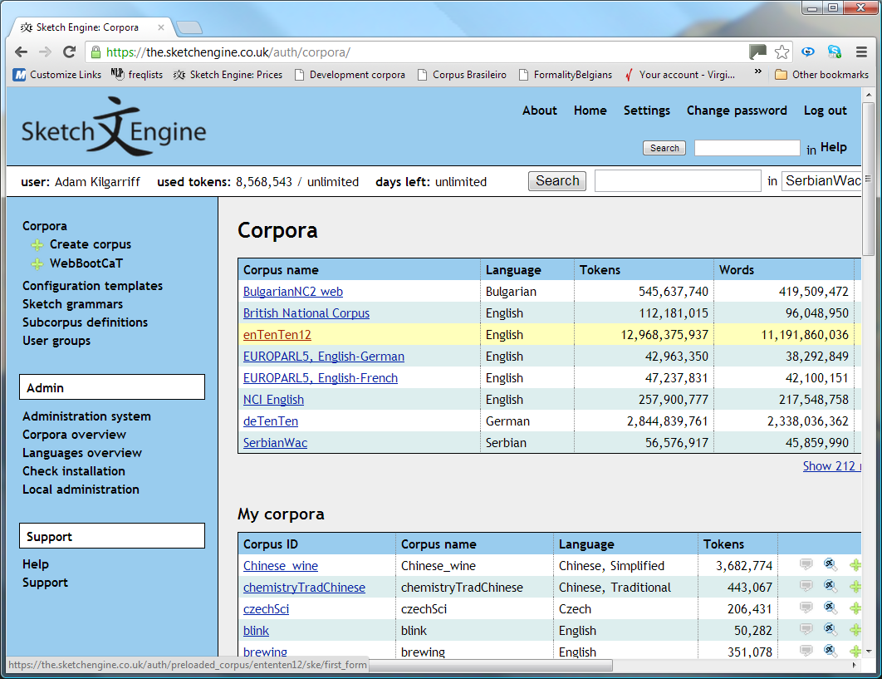

Slide 9
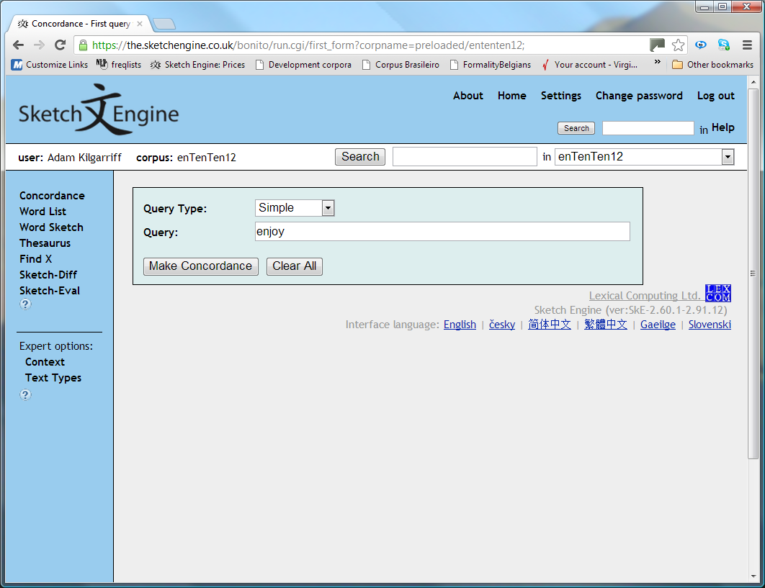

Slide 10
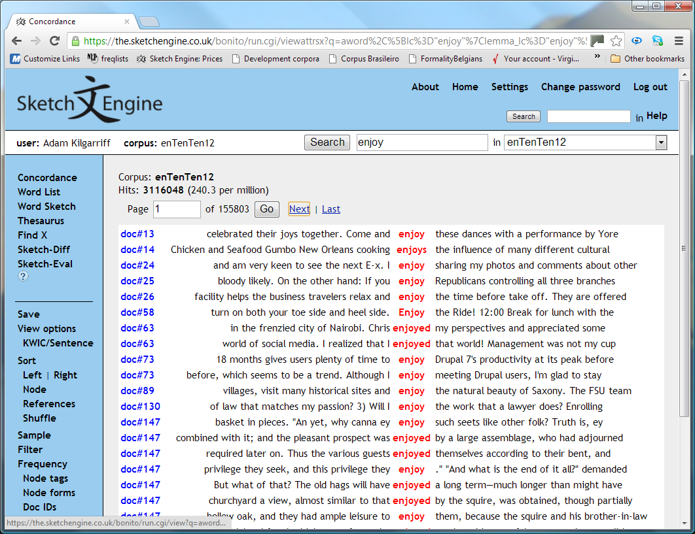

Slide 11
Findings…
- 3 million hits
Plenty of evidence
- Lemmatised
enjoy enjoys enjoying enjoyed
- Start with a sample

Slide 12
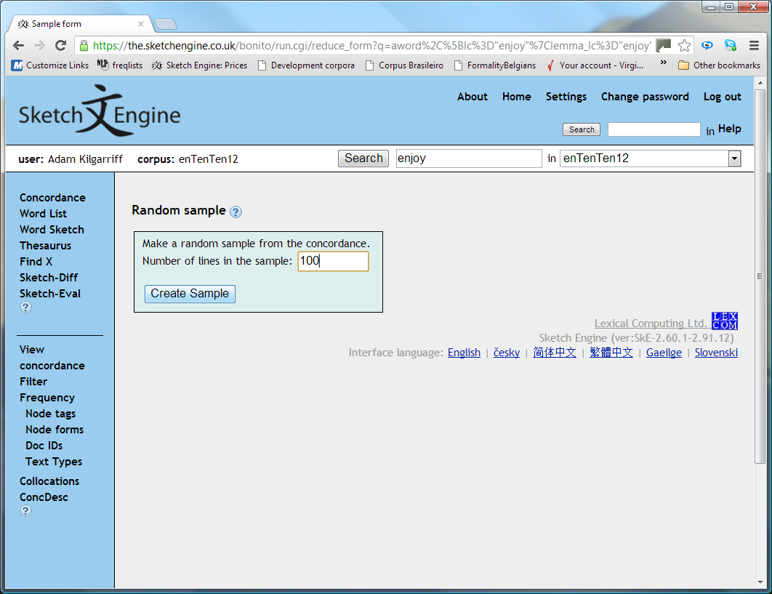

Slide 13
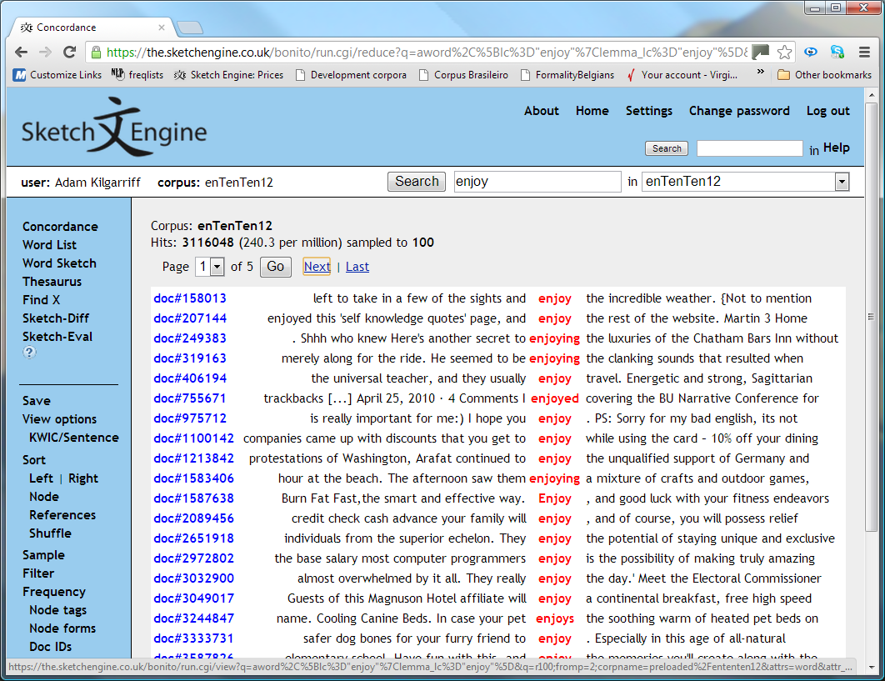

Slide 14
Getting more out of our corpus
- Sort
on right context

Slide 15
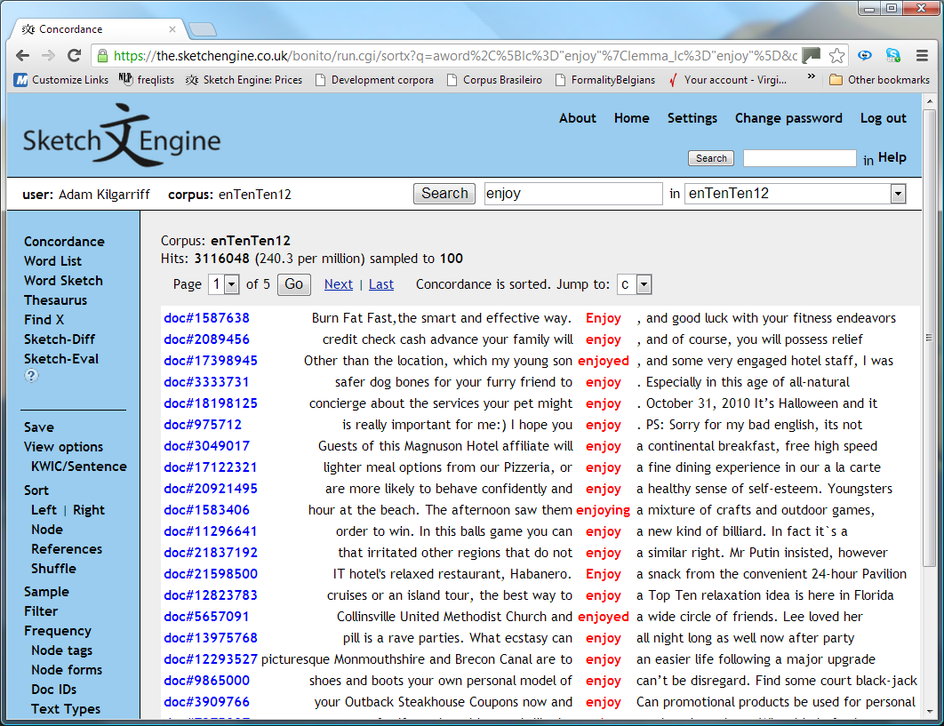

Slide 16
Any patterns?
- Recurring themes
Do you spot any?
Same concordance again:

Slide 18
What do we enjoy?
- breakfast, dining, snack
- Object is often ‘meal’
- Scroll on down, looking for more patterns
- To see more context, click on word
What is a furry friend?

Slide 19
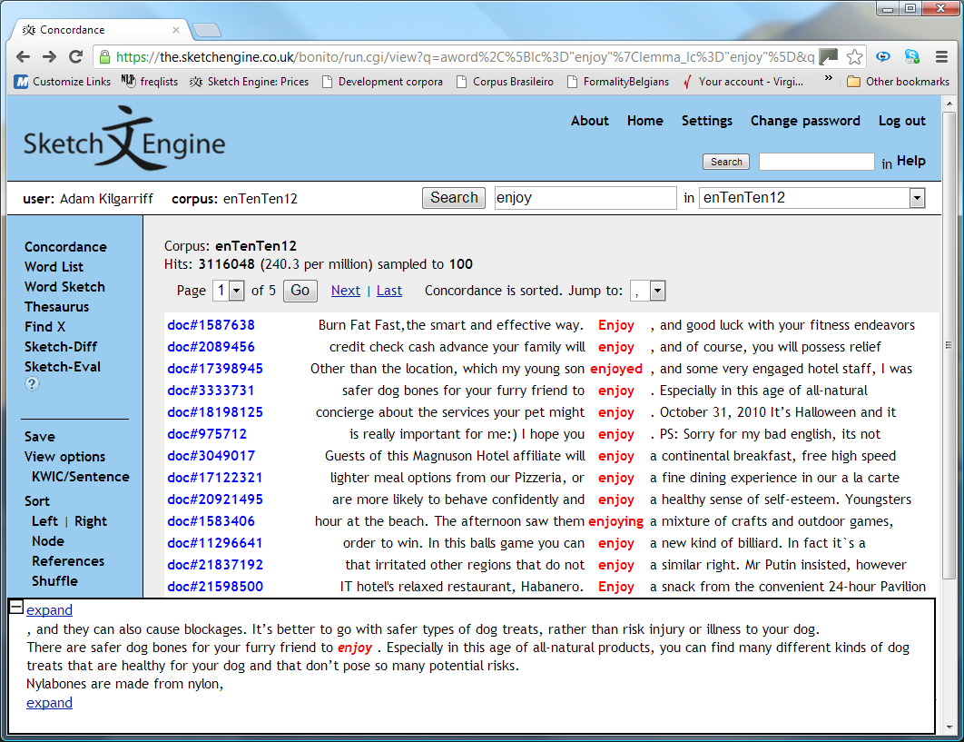

Slide 20
Too much data?
- So much data to look through
- Can the computer help?
yes

Slide 21
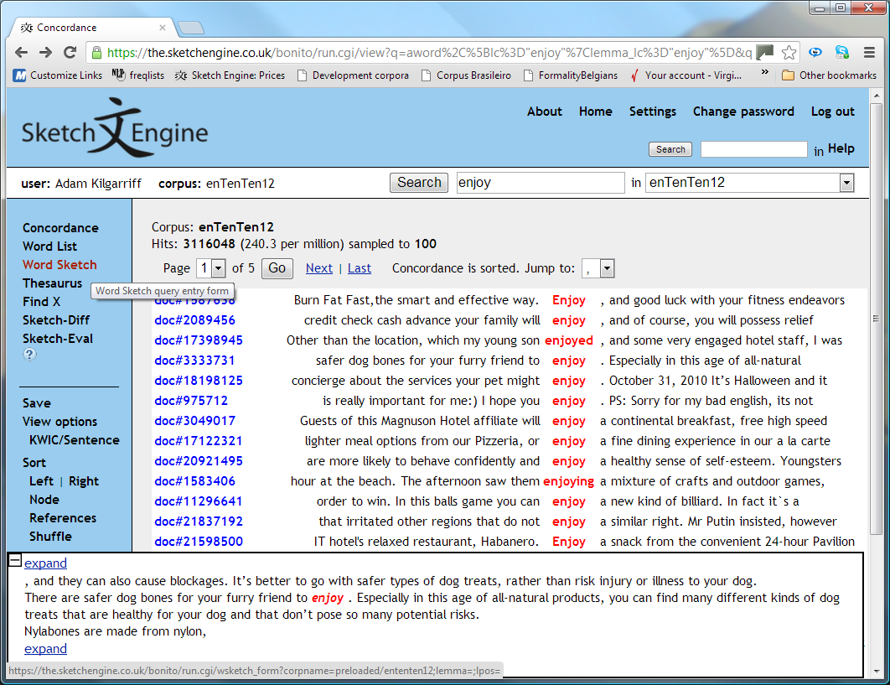

Slide 22
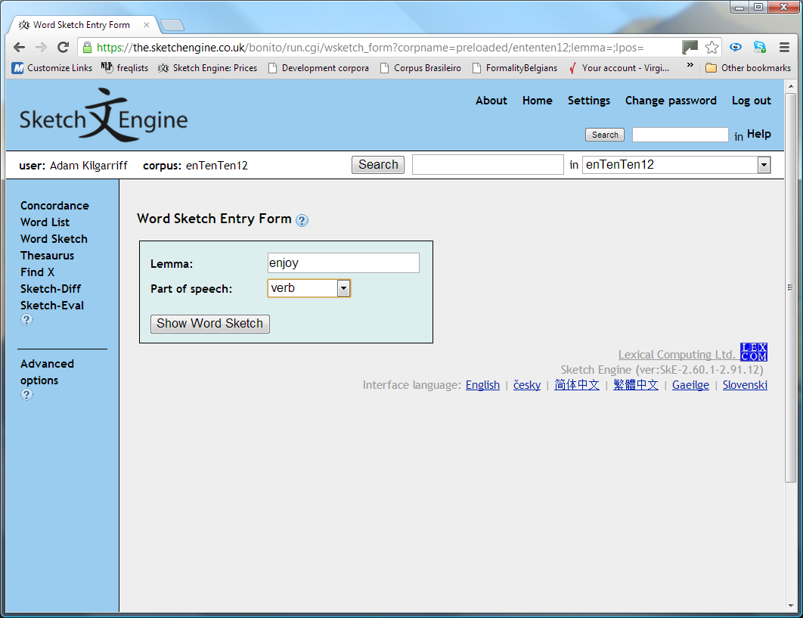

Slide 23
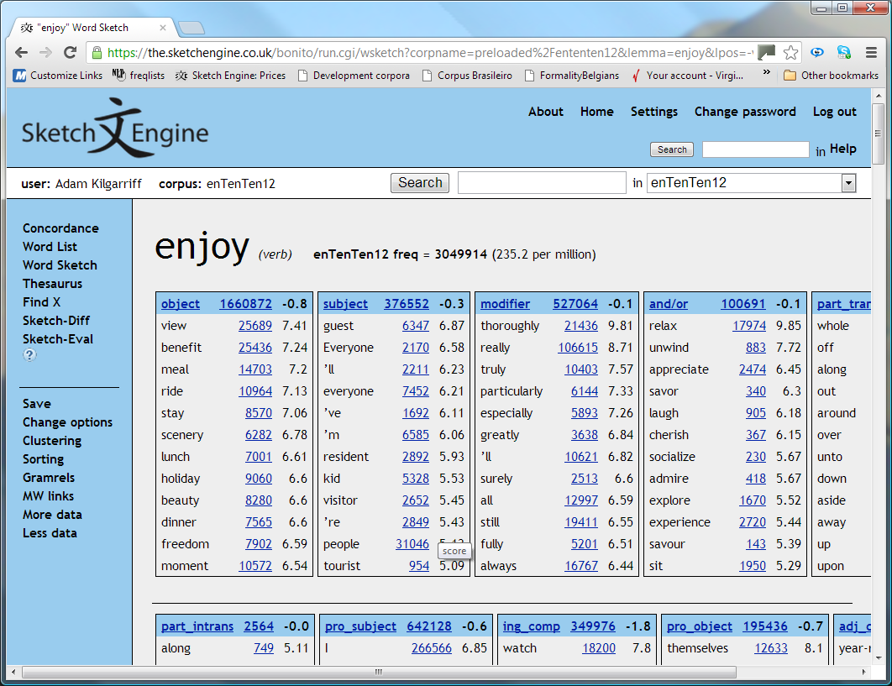

Slide 24
Grammar
- We can cluster the objects

Slide 25
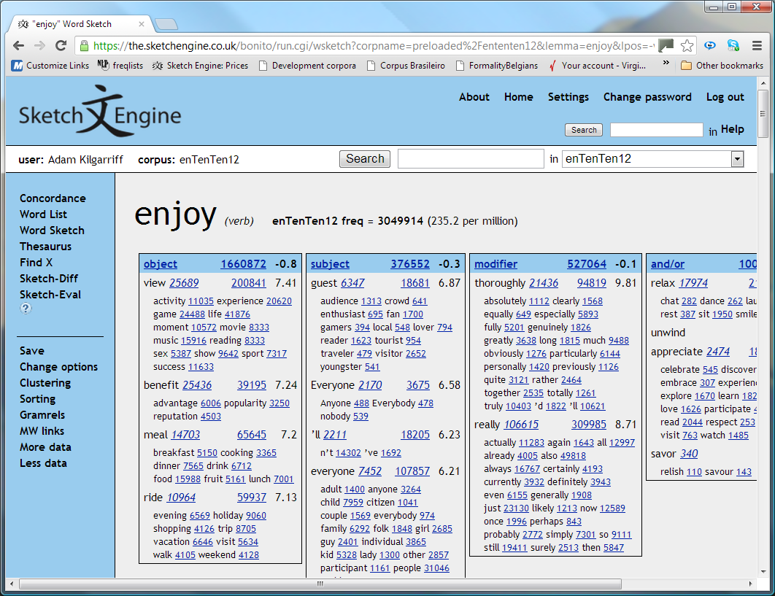

Slide 26
Enjoy
- Views, benefits, meals, rides
Good summary of the things we enjoy
- Scrolling down …

Slide 27
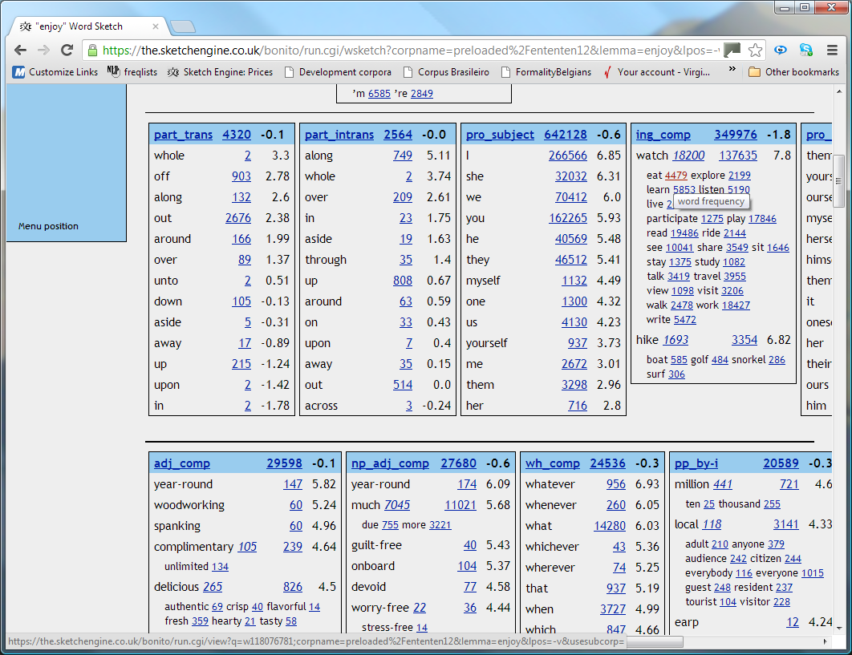

Slide 28
Patterns
- ing_comp
Strong pattern for enjoy
click on any item in Word Sketch to get more information
ing_comp: hike

Slide 29
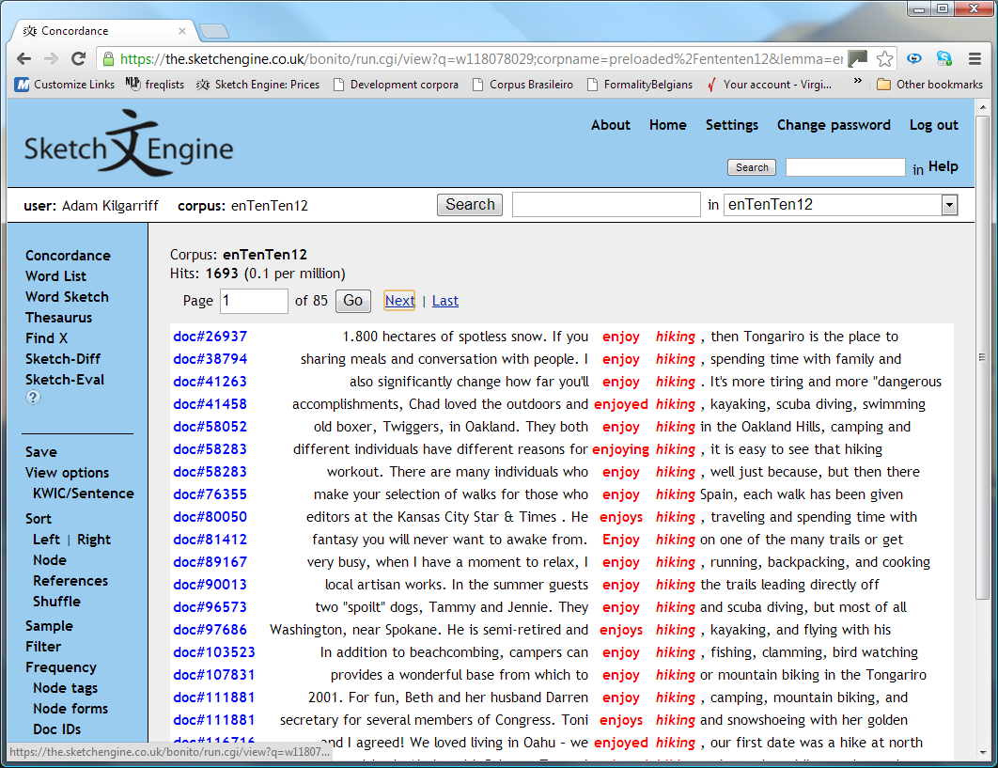

Slide 30
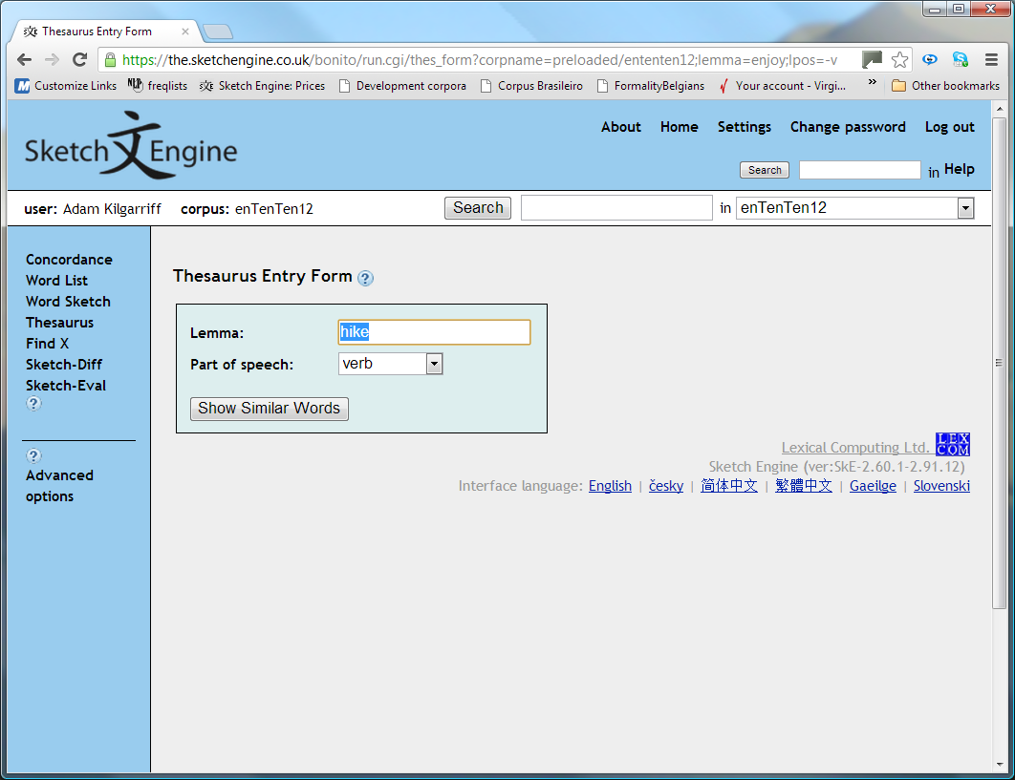

Slide 31
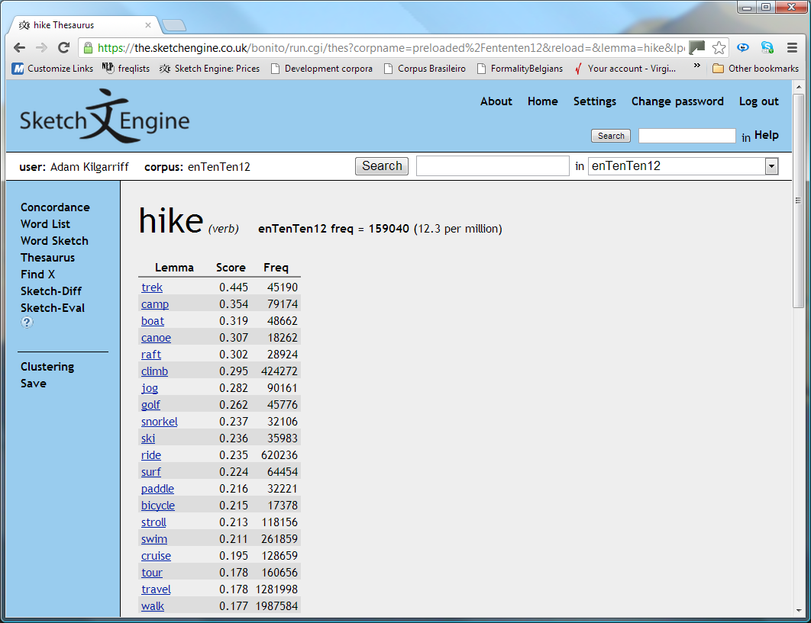

Slide 32
Thesaurus
- ‘Distributional Thesaurus’
Which word shares most collocates with target word?
- What will come top for grandfather?

Slide 33
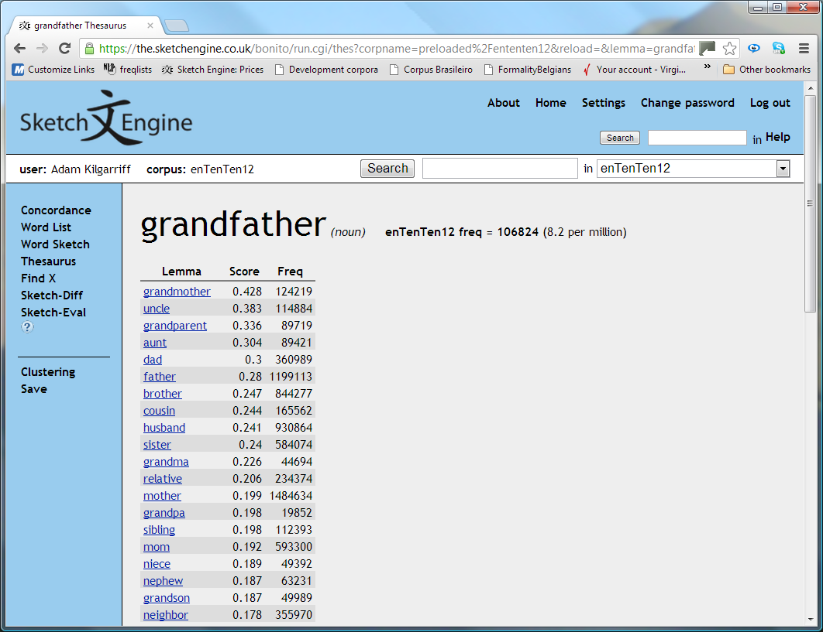

Slide 34
“Sketch Diff”
Verbs they are subject of (middle column)
What grandmothers do
What they both do
What grandfathers do

Slide 35
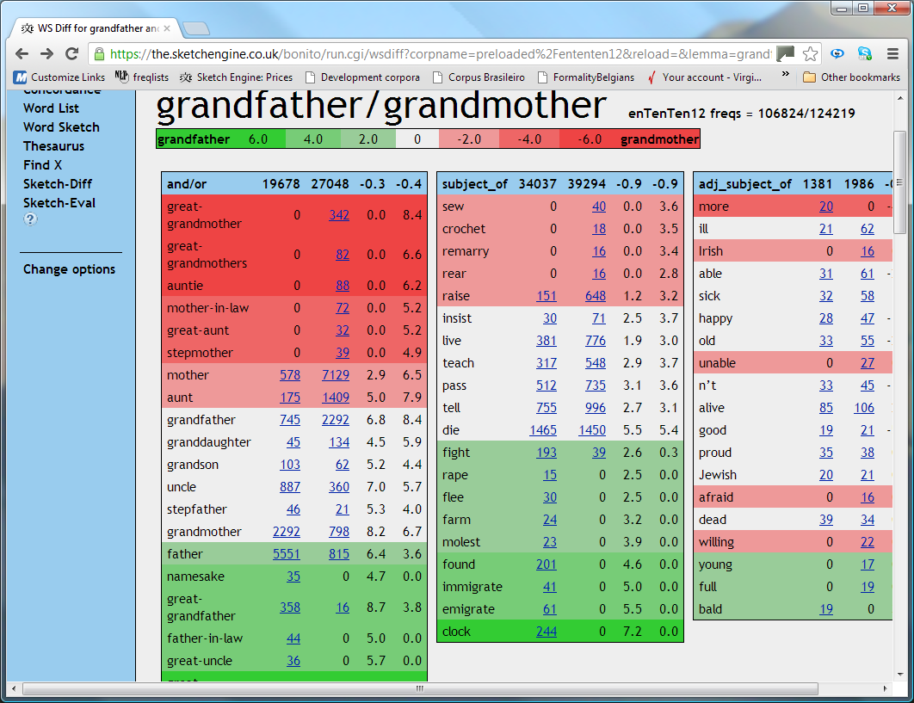

Slide 36
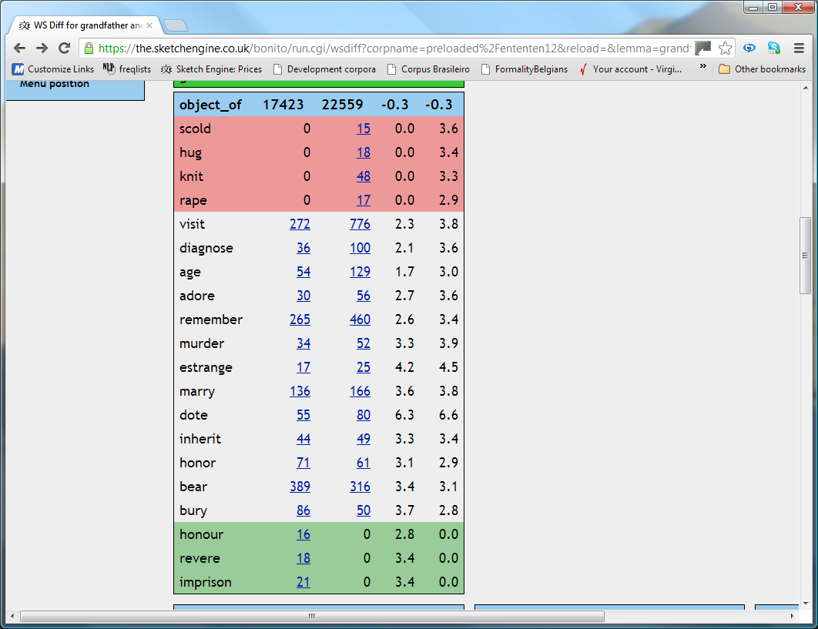

Slide 37
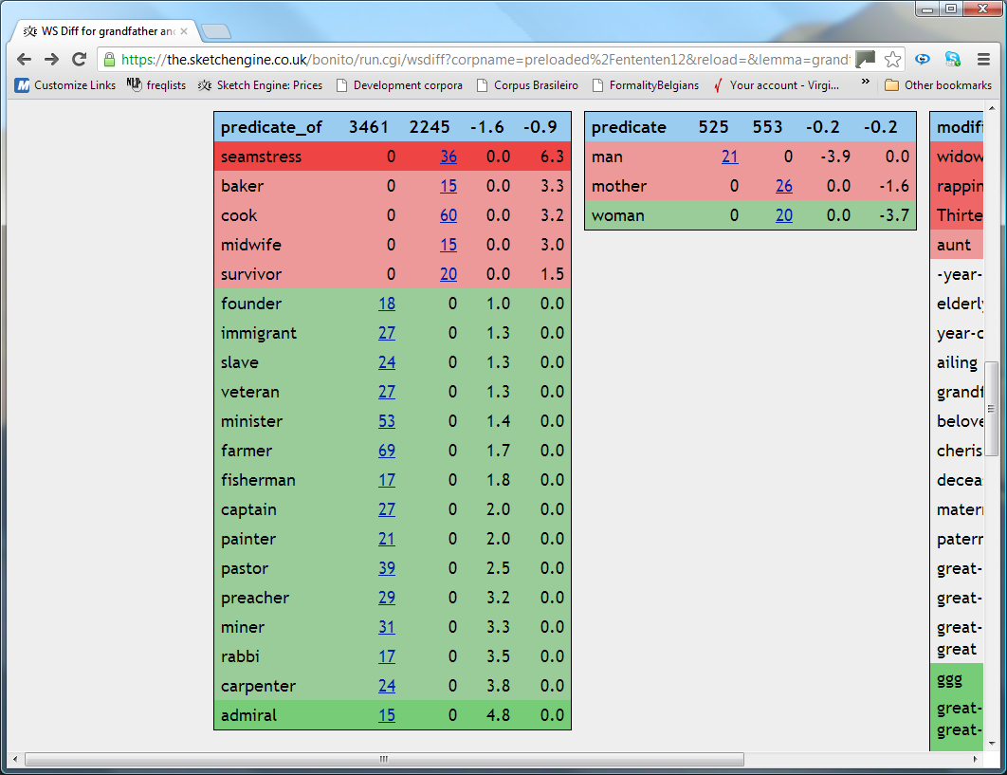

Slide 38
What corpora?
- Public ones
- Your own

Slide 39
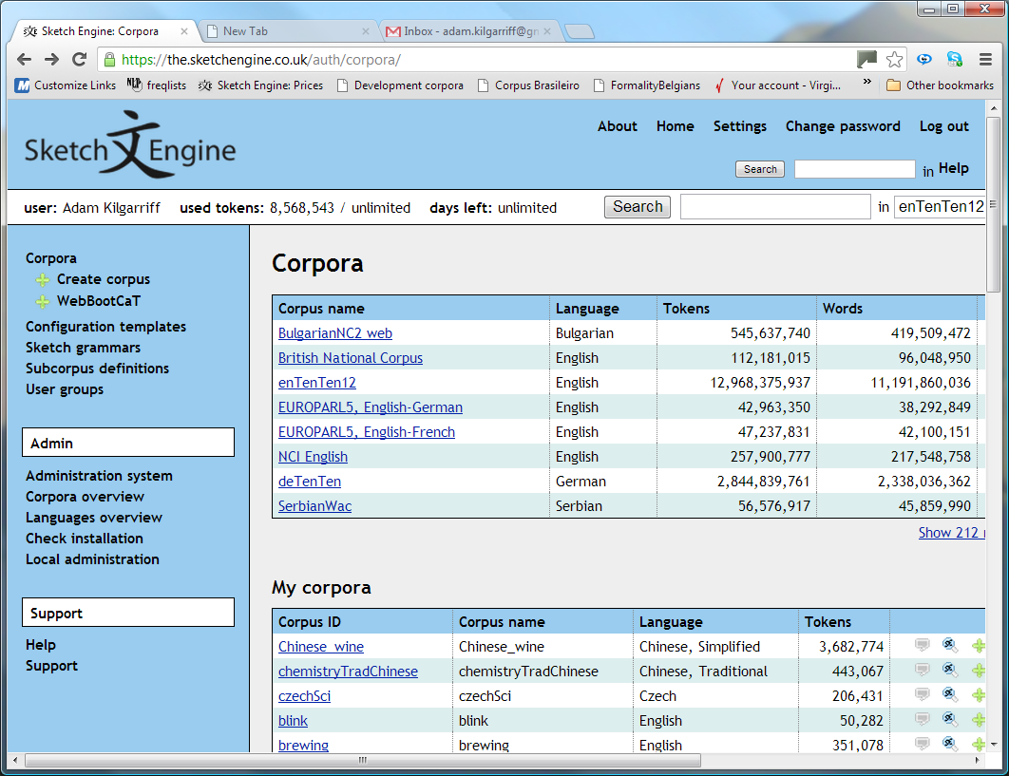

Slide 40
Public corpora
- Many languages
Show # more corpora button
220+ corpora
60+ languages

Slide 41
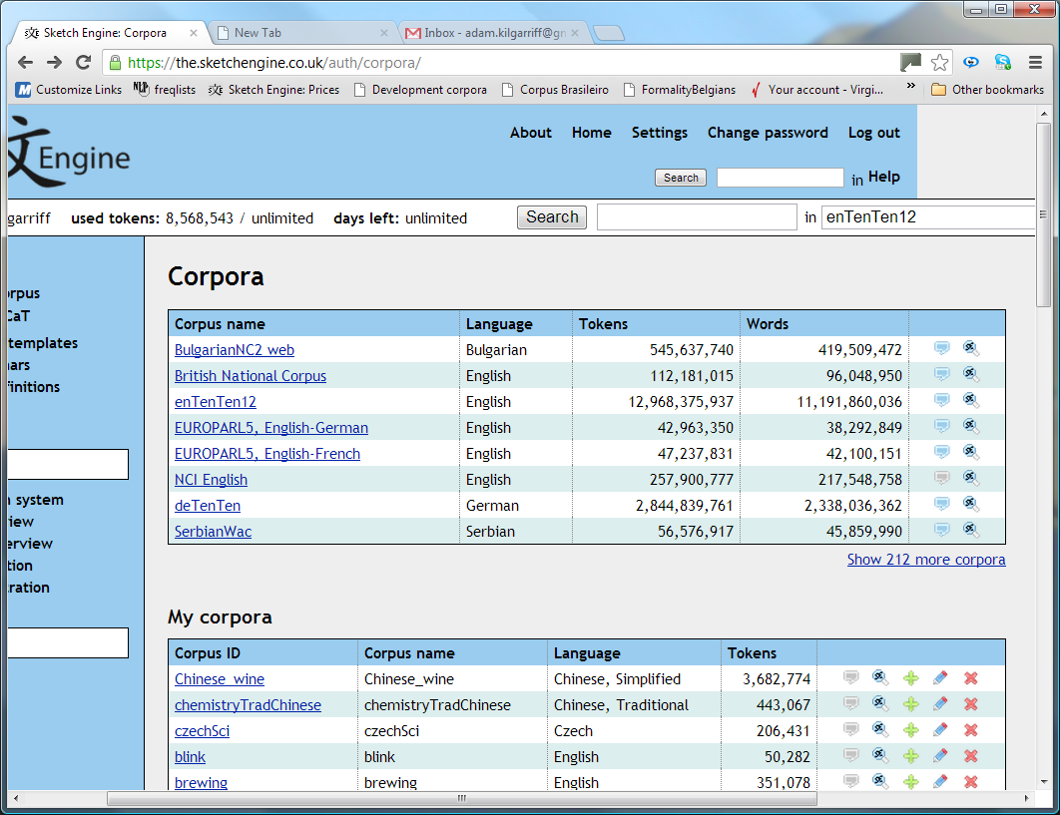

Slide 42
Your own corpora
WebBootCaT: a corpus building tool
Students can work on a topic close to their hearts
interests, an assignment
www.sketchengine.co.uk

Slide 43
Thank you.
www.sketchengine.co.uk
90 day free trial
LLAS_0113
Facebook.com/SketchEngine
Twitter.com/SketchEngine
YouTube.com/TheSketchEngine
robyn.woodrow@sketchengine.co.uk

