Slide 1
Harnessing new media, pedagogical innovation and new approaches to design
National Teaching
Fellow 2012
Ascilite fellow 2012
Gráinne Conole, University of Leicester
25th January 2013
E-learning symposium
University of Southampton

Slide 2
Outline
What is innovative teaching?
E-Learning timeline
The technological context
Pedagogical approaches
Disaggregation of education
Learning design
Changing practices

Slide 3
Facets of learning
Encourages reflection
Enables dialogue
Fosters collaboration
Applies theory
Creates community
Enables creativity
Evidence of learning
Motivates the learners!

Slide 4
E-Learning timeline
Learning Management Systems
Social and participatory media
Massive Open Online Courses
Open Educational Resources
E-books and smart devices
The Internet and the Web
Multimedia resources
Gaming technologies
Learning objects
Learning Design
Mobile devices
Virtual worlds
80s
93
94
95
98
99
00
01
04
05
07
08
Notes:
§

Slide 5
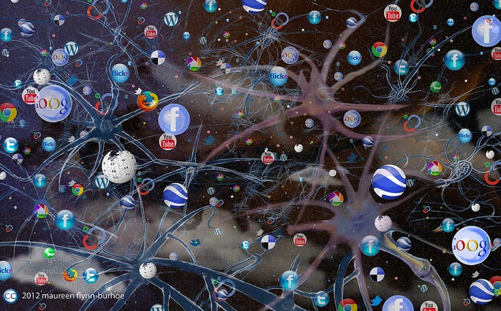
Technologies
Transforming everything we do
New forms of communication and collaboration
Multiple rich representations
Tools to find, create, manage, share
Networked, distributed, peer reviewed, open
Complex, dynamic and co-evolving
http://www.flickr.com/photos/oceanflynn/6638184545/

Slide 6
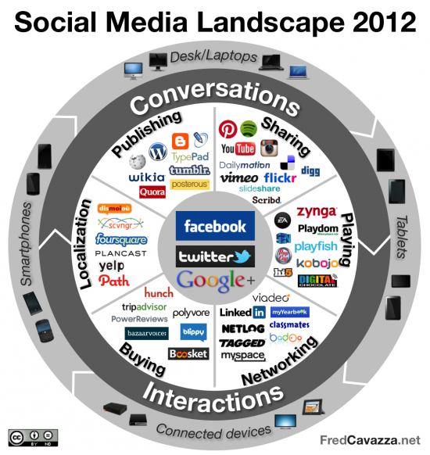
Peer critiquing
Collective aggregation
User generated content
Open
Networked
Personalised

Slide 7
Technological trends
Mobiles and e-books
Personalised learning
Cloud computing
Ubiquitous learning
BYOD (Bring your own device)
Technology-Enhanced learning spaces
Learning analytics
http://www.nmc.org/horizon-project

Slide 8
The MATEL study
http://www.menon.org/matel/
Productivity and creativity
Networked collaboration
Content creation
Visualisation and simulation
Learning Management Systems
Learning environment
Games
Devices, interfaces and connectivity

Slide 9
Pedagogical approaches
Drill & practice
learning
Mobile
learning
Situated
learning
Immersive
learning

Slide 10
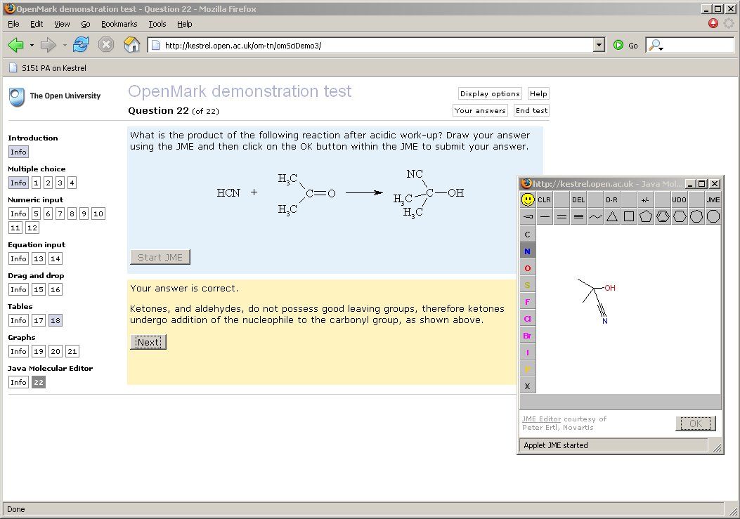
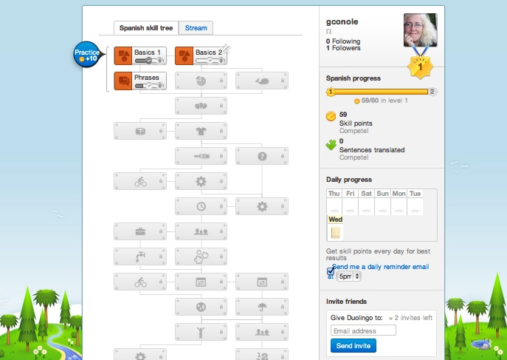
Drill and practice learning

Slide 11
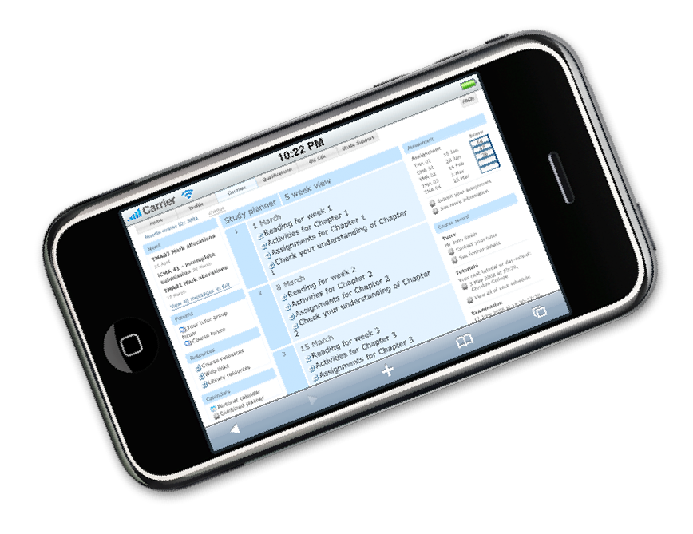
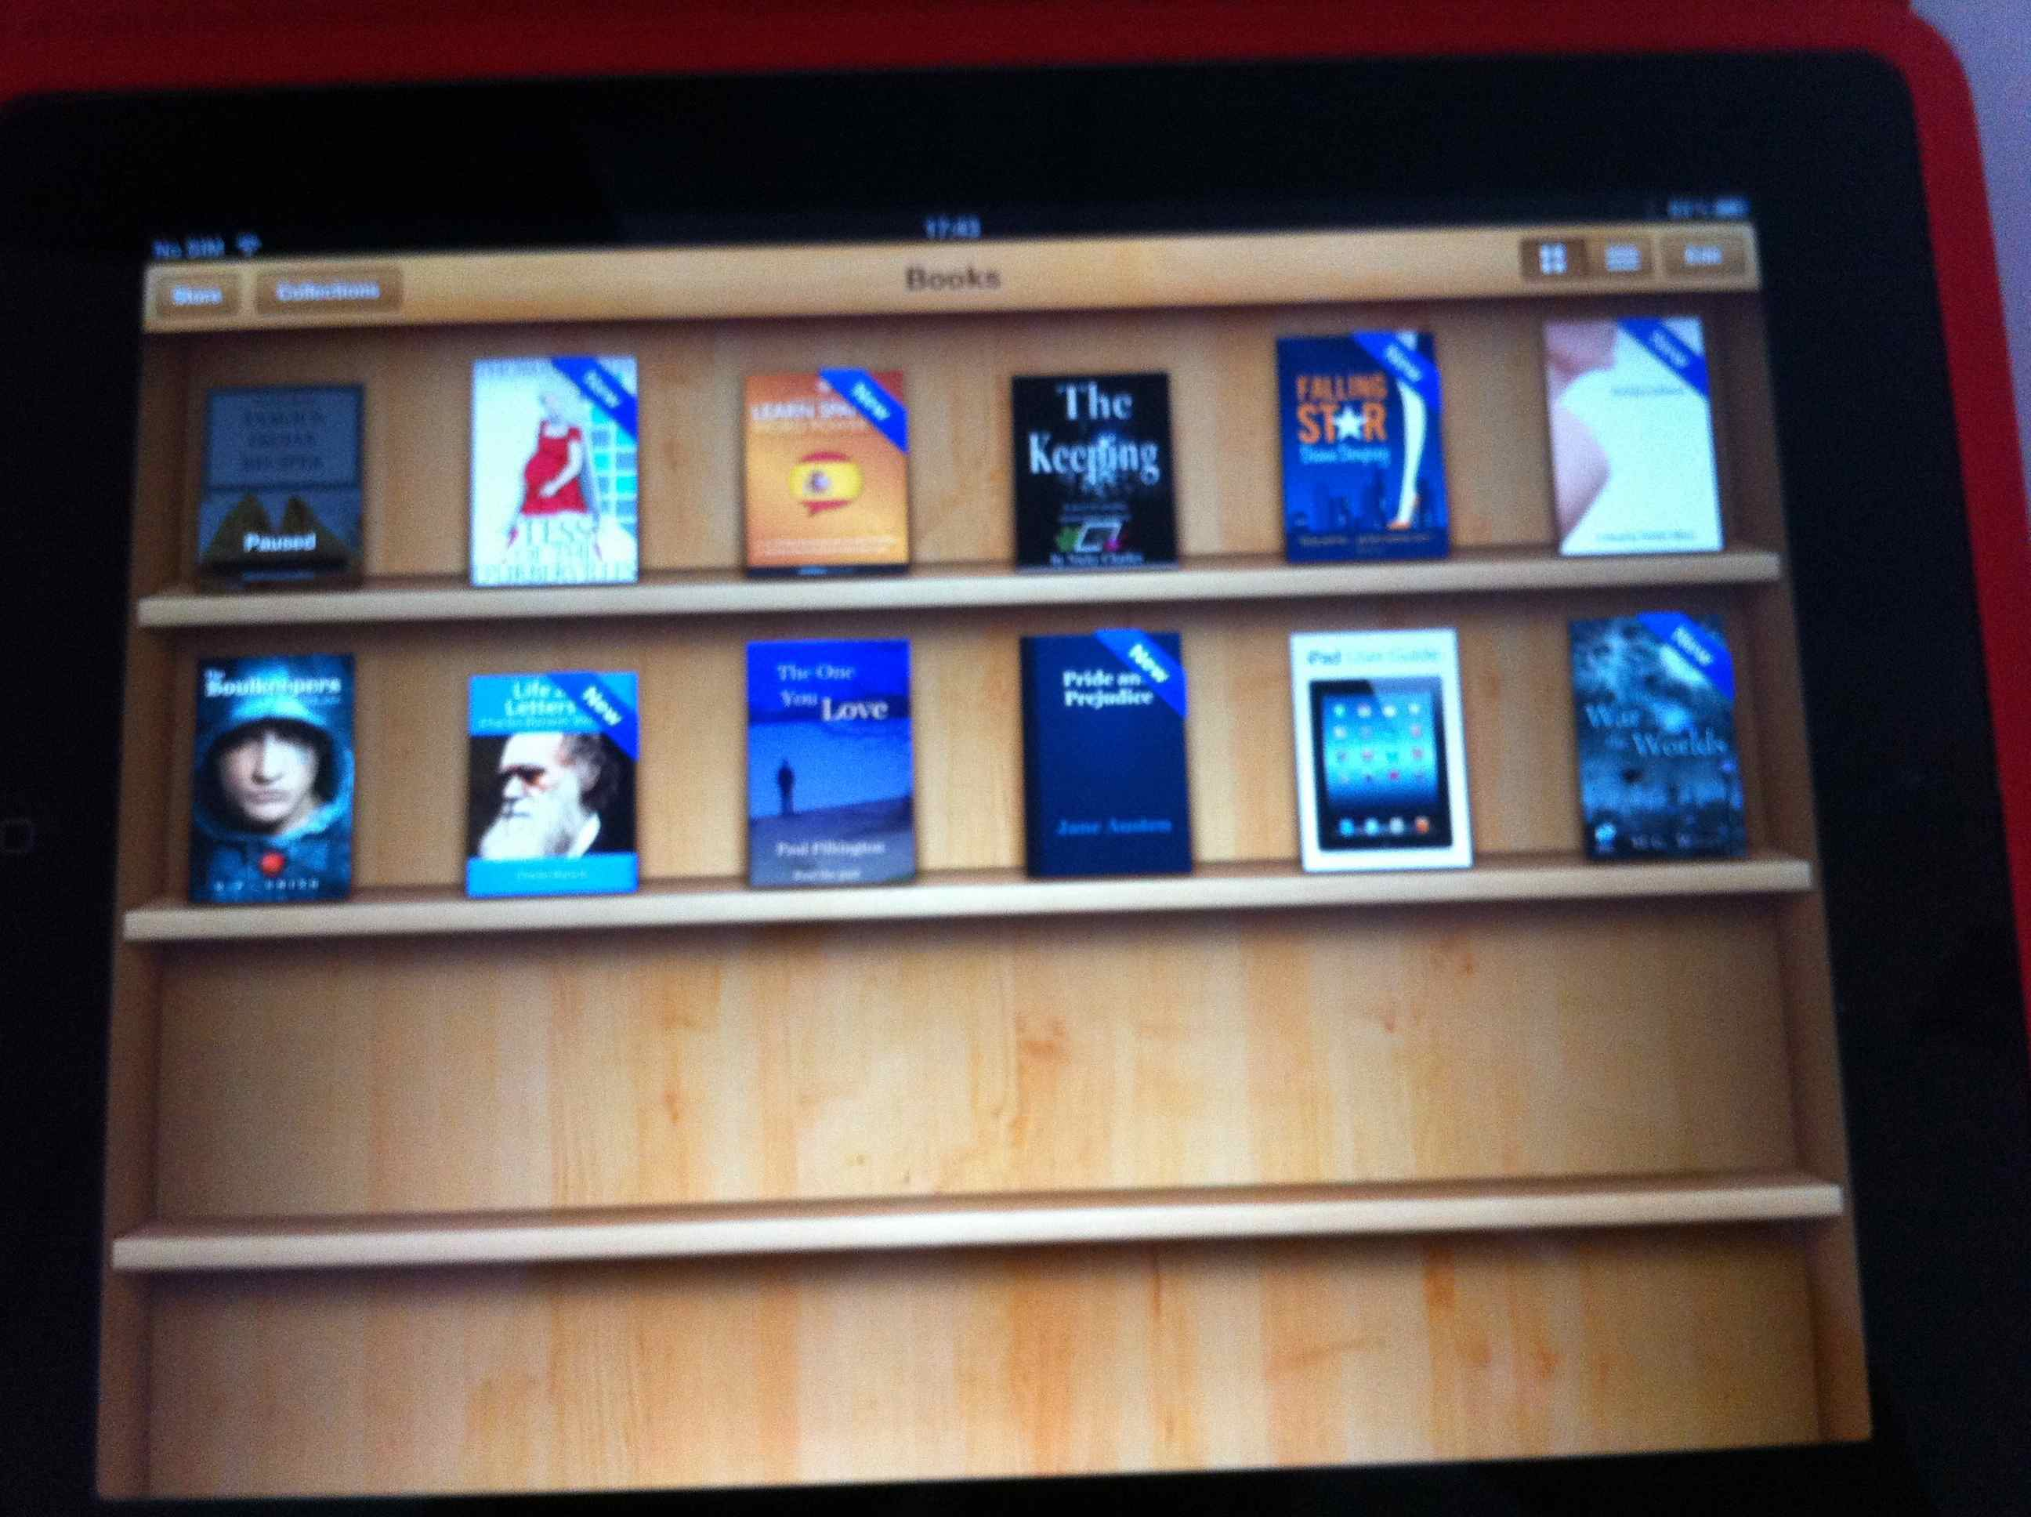
Mobile learning
Study calendars
E-books
Learning resources
Online modules
Annotation tools
Mind mapping tools
Communication mechanisms

Slide 12
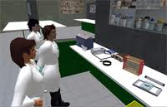
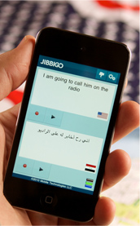
Situated learning
Archeological digs
Medical wards
Art exhibitions
Cyber-law
Virtual language exchange
Beyond formal schooling
http://www.jibbigo.com/

Slide 13
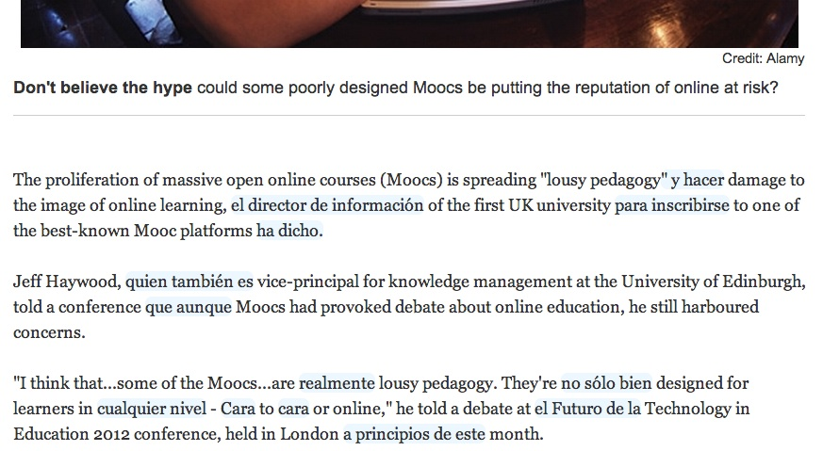
Immersive learning

Slide 14
Disaggregation of education
Resources
Learning
pathways
Support
Accreditation
http://www.flickr.com/photos/emclibrary/2459359483/

Slide 15
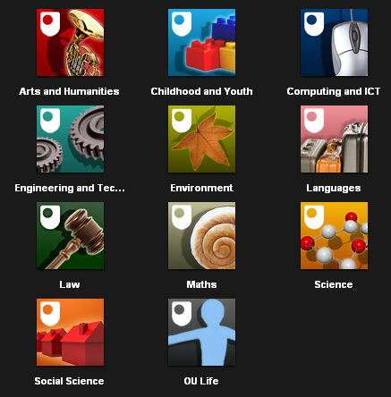
Resources
Over ten years of the Open Educational Resource (OER) movement
Hundreds of OER repositories worldwide
Presence on iTunesU
Podcasts - iTunes U

Slide 16
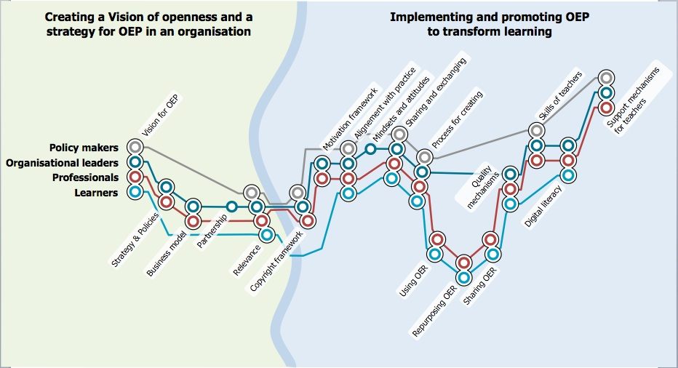
The OPAL metromap
Evaluation shows lack of uptake by teachers and learners
Shift from development to community building and articulation of OER practice
http://www.oer-quality.org/

Slide 17
POERUP outputs
An inventory of more than 100 OER initiatives http://poerup.referata.com/wiki/Countries_with_OER_initiatives
11 country reports and 13 mini-reports http://poerup.referata.com/wiki/Countries
7 in-depth case studies
3 EU-wide policy papers

Slide 18
Free
Distributed global community
Social inclusion
MOOCS
High dropout rates
Learning income not learning outcome
Marketing exercise
http://olds.ac.uk
www.evolllution.com/distance_online_learning/massive-open-online-learning-creativity-and-competency/

Slide 19
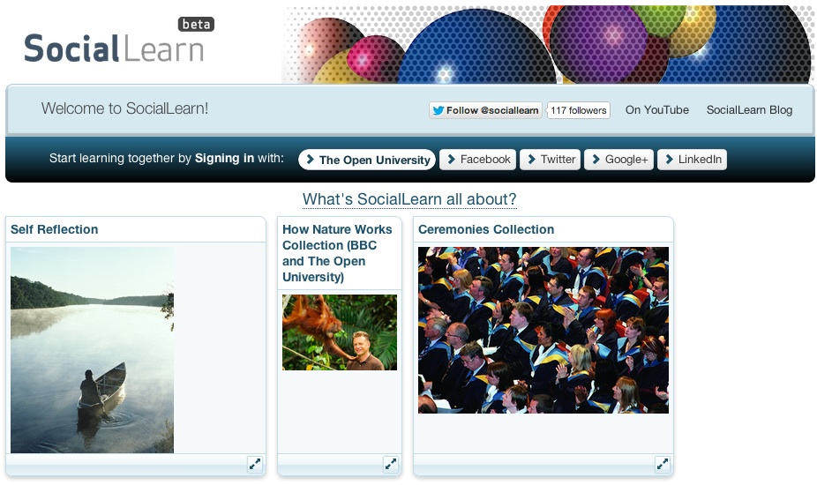
Learning pathways
Guided pathways through materials
Can promote different pedagogical approaches

Slide 20
Support
Computer assisted
Peer support
Tutor support
Community support
Mentoring

Slide 21
Accreditation
Peer to Peer University
OER University
www.p2pu.org/en/
wikieducator.org/OER_university/

Slide 23
Promise and reality
Social and participatory media offer new ways to communicate and collaborate
Not fully exploited
Wealth of free resources and tools
Replicating bad pedagogy
Lack of time and skills

Slide 24
Learning Design
Shift from belief-based, implicit approaches to design-based, explicit approaches
Learning Design
A design-based approach to creation and support of courses
Encourages reflective, scholarly practices
Promotes sharing and discussion

Slide 25
http://www.larnacadeclaration.org/

Slide 26
Gabi Witthaus
Ming Nie

Slide 27
The 7Cs of Learning Design
Vision
Conceptualise
Activities
Capture
Communicate
Collaborate
Consider
Synthesis
Combine
Implementation
Consolidate
http://www2.le.ac.uk/projects/oer/oers/beyond-distance-research-alliance/7Cs-toolkit

Slide 28
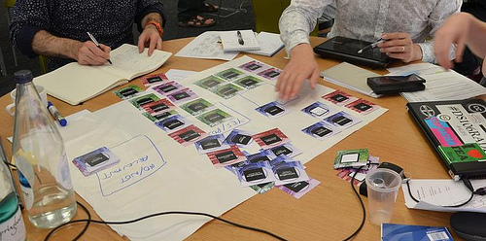
Course features
http://cloudworks.ac.uk/cloud/view/5950
Pedagogical approaches
Principles
Guidance and support
Content and activities
Reflection and demonstration
Communication and collaboration

Slide 29
Theory based
Practice based
Cultural
Principles
Aesthetics
Professional
Political
Sustainable
International
Serendipitous
Community based

Slide 30
Inquiry based
Problem based
Case based
Pedagogical
approaches
Dialogic
Collaborative
Situative
Constructivist
Vicarious
Didactic
Authentic

Slide 31
Learning pathway
Mentoring
Peer support
Guidance &
Support
Scaffolded
Step by step
Study skills
Library support
Tutor directed
Help desk
Remedial support

Slide 32
Brainstorming
Concept mapping
Annotation
Content &
Activities
Assimilative
Modeling
Jigsaw
Pyramid
Aggregating
resources
Learner generated
content
Information
handling

Slide 33
Diagnostic
E-Assessment
E-Portfolio
Reflection &
Demonstration
Formative
Feed forward
Summative
Reflective
Peer feedback
Vicarious
Presentation

Slide 34
Structured debate
Flash debate
Group project
Communication &
Collaboration
Group aggregation
Peer critique
Group
presentation
Group project
Question &
Answer
Flash debate
For/Against debate

Slide 35
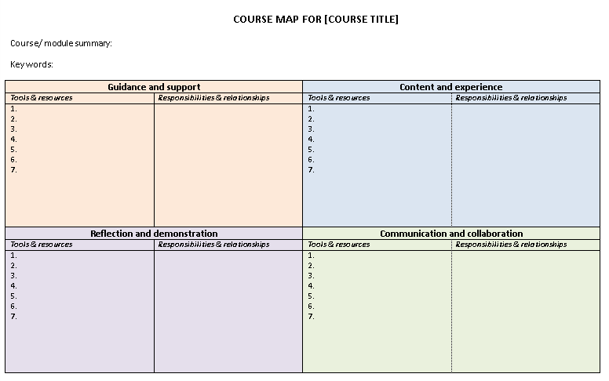
Course Map
Purpose: To start mapping out your module/course, including your plans for guidance and support, content and the learner experience, reflection and demonstration, and communication and collaboration.
E-tivity Rubric: http://tinyurl.com/SPEED-e5

Slide 36
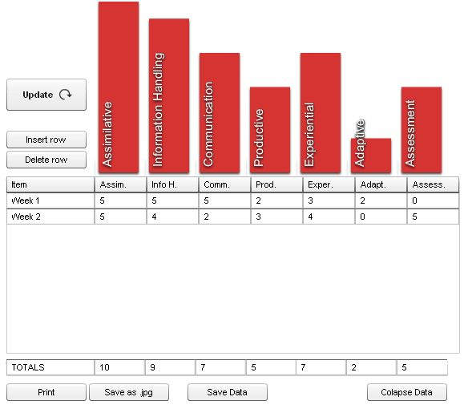
Activity profile
Types of learner activities
Assimilative
Information Handling
Communication
Production
Experiential
Adaptive
Assessment

Slide 37
Learning Outcomes
Start
End
Assessment

Slide 38
The 7Cs of Learning Design
Vision
Conceptualise
Activities
Capture
Communicate
Collaborate
Consider
Synthesis
Combine
Implementation
Consolidate

Slide 39
Conceptualise
Vision for the course, including:
Why, who and what you want to design
The key principles and pedagogical approaches
The nature of the learners
Conceptualise
Course Features
Personas

Slide 40
Capture
Finding and creating interactive materials
Undertaking a resource audit of existing OER
Planning for creation of additional multimedia such as interactive materials, podcasts and videos
Mechanism for enabling learners to create their own content
Capture
Resource Audit
Learner Generate Content

Slide 41
Communicate
Designing activities that foster communication, such as:
Looking at the affordances of the use of different tools to promote communication
Designing for effective online moderating
Communicate
Affordances
E-moderating

Slide 42
Collaborate
Designing activities that foster collaboration, such as:
Looking at the affordances of the use of different tools to promote collaboration
Using CSCL (collaborative) Pedagogical Patterns such as JIGSAW, Pyramid, etc.
Collaborate
Affordances
CSCL Ped. Patterns

Slide 43
Consider
Designing activities that foster reflection
Mapping Learning Outcomes (LOs) to assessment
Designing assessment activities, including
Diagnostic, formative, summative assessment and peer assessment
Collaborate
LOs/Assessment
Assessment
Ped. Patterns

Slide 44
Combine
Combining the learning activities into the following:
Course View which provides a holistic overview of the nature of the course
Activity profile showing the amount of time learners are spending on different types of activities
Storyboard: a temporal sequence of activities mapped to resources and tools
Learning pathway: a temporal sequence of the learning designs
Combine
Course View
Activity Profile
Storyboard
Learning Pathway

Slide 45
Consolidate
Putting the completed design into practice
Implementation: in the classroom, through a VLE or using a specialised Learning Design tool
Evaluation of the effectiveness of the design
Refinement based on the evaluation findings
Sharing with peers through social media and specialised sites like Cloudworks
Combine
Implementation
evaluation
Refinement
Sharing

Slide 46
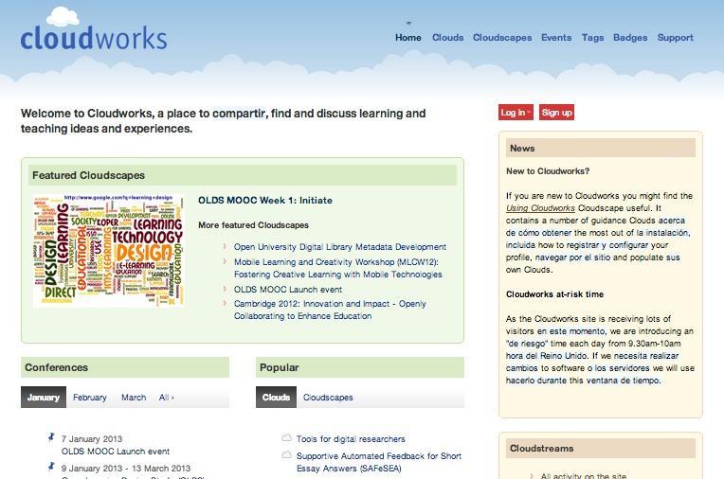

Slide 47
Changing practices
Nature of learning, teaching and research is changing
It’s about
Harnessing new media
Adopting open practices
New business models are emerging

Slide 48
http://olds.ac.uk
OLDS Learning Design MOOC
http://www.slideshare.net/GrainneConole
http://www2.le.ac.uk/departments/beyond-distance-research-alliance
grainne.conole@le.ac.uk
http://e4innovation.com

