Slide 1
WELCOME TO Language Futures : Languages in Higher Education 2012
5th & 6th July 2012
Edinburgh
#LLASconf2012

Slide 2
Evaluating assignment e-feedback in Higher Education
María Fernández-Toro, The Open University Elena Polisca, The University of Manchester
Languages in Higher Education 2012

Slide 3
The e-Feedback evaluation project
Rationale
Assignment feedback is consistently reported by students as an area for improvement
Technology can provide better ways of delivering feedback, but how much does it really help?
The OU provides a good context for evaluating the actual strengths and weaknesses of different modes of e-feedback
The University of Manchester provides a good context for determining to which extent the lessons learnt within the OU are applicable to other educational settings

Slide 4
The e-Feedback evaluation project
Aims
To examine the ways in which students and tutors use spoken and written e‑feedback
Today → Introducing the FACT analysis method
To evaluate the perceptions and preferences of tutors and students in relation to spoken and written e‑feedback
Today → Preliminary results from OU tutor & student surveys
To investigate the ways in which students engage with the written and spoken e‑feedback that they receive
Today → Evaluation of peer feedback at University of Manchester

Slide 5
Analysing assignment feedback
Analysis criteria based around two dimensions:
Whether feedback focuses on strengths or weaknesses
How much information the feedback provides, cf ‘depth’ of feedback (Brown & Glover 2006) → layers of scaffolding
Analysis tool: Feedback Analysis Chart for Tutors (FACT)
Provides a visual ‘profile’ of a tutor’s feedback

Slide 6
Layers of scaffolding in assignment feedback
Layers | Comments focusing on weaknesses | Comments focusing on strengths
1 | Error identified only | Strength identified only
2 | Error categorised, but not corrected | Strength categorised or described as per marking criteria
3 | Error corrected | Illustrated with specific example from student’s performance
4 | Explanation given | Explanation given
5 | Advice given on how to prevent errors in future performance | Advice given on how to develop exisiting strengths in future
Manos blancos
??
Good work
✓
Manos blancos → Agreement
You use a wide range of language structures
Manos blancos → blancas
No digo que quieran... → Good use of the subjunctive
Although it ends in O, ‘mano’ is a feminine noun.
This connector makes it very clear that a new section is starting here.
Revise section 6.1 of your grammar book
Good, you could also look up...

Slide 7
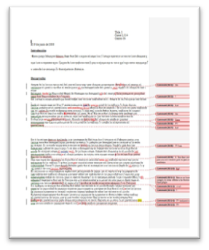
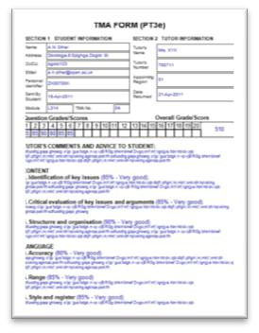
Analysing what? Feedback on language assignments at the OU
Every year, OU language tutors return...
36,600 electronic feedback summary forms
19,000 annotated word-processed scripts
18,000 audio files containing spoken feedback
annotated script
feedback summary
Writing assignment
Our sample:
100 writing assignments
100 speaking assignments
4 levels (9 tutors per level)
108 students (3 per tutor)
Feedback consists of:
200 e-feedback forms
100 annotated scripts
100 audio files
Student
Tutor
Speaking assignment
Well done!
feedback
summary
audio-recorded
feedback

Slide 8
Student and tutor surveys
OU students:
 | Beginner | Lower Int. | Upper Int. | Advanced | Total
Chinese | 27 |  |  |  | 27
French | 106 | 72 | 23 | 31 | 232
German | 63 | 41 | 16 | 9 | 129
Italian | 85 | 46 |  |  | 131
Spanish | 90 | 80 | 18 | 22 | 210
Welsh | 7 |  |  |  | 7
Total | 378 | 239 | 57 | 62 | 736
OU tutors: N=96 (same modules as above)

Slide 9
Survey preliminary results
Most important aspect of feedback for the students
According to the tutors:
According to the students:

Slide 10
Survey preliminary results
Medium preferences for giving and receiving feedback
Most useful medium?
Least useful medium?
Tutors’ choices
Students’ choices

Slide 13
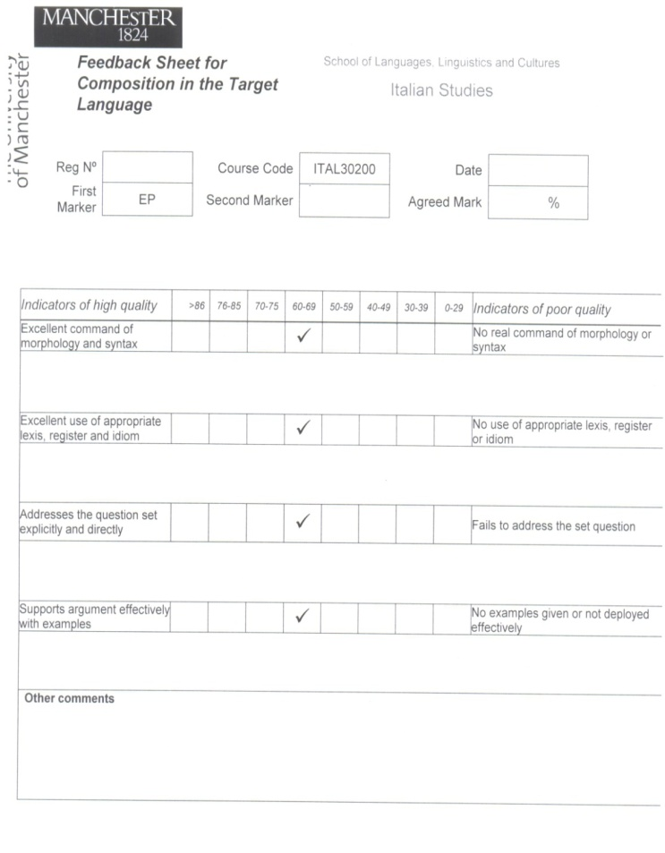
Peer feedback: How do students engage with feedback?
In Manchester, students:
Receive paper-based feedback
Receive audio-feedback
Are involved in peer-to-peer feedback
Beginner and finalist groups
Composition / paraphrase work
Students provide corrections on paper
Students provide comments on work (audio or written) + mark
Tutor revises mark and gives further inputs

Slide 14
Peer feedback: How do students engage with feedback?
Feedback type: | Tutor to Student 1 | Student 1 to Student 3
Morphology + Syntax | Italian reads very well, particularly you have used –ING forms (gerunds) very well; Italian is correct but mistakes in spelling and gender of x is feminine. Language is coming on; I am pleased | Essay reads well, morph and syntax generally correct. Small mistakes: you use article la; Italians don’t use articles with cities. Two examples of lack of agreements (quotes them) Syntax: here I would say x
Lexis + Register | Appropriate lexis: high vocab | Lexis is excellent (gives examples)
Content | Good to divide texts in two areas: data + opinion I was expecting more personal engagement! Very clinical! | Addressed q. properly. Appropriate structure (short intro, I like conclusion). Very Italian question in intro, well done.
Examples used | Good percentages and opinions
Additional comments | Good work, for future mind ‘small’ mistakes | I really enjoyed reading your essay

Slide 15
Peer feedback: How do students engage with feedback?
Feedback type: | Tutor to Student 2 | Student 2 to Student 4
Morphology + Syntax | Pleased to see Italian is consistent with last 2 pieces. Language is fluent. Morphology is correct but careful with prepositions and articles | Italian reads well. You use subjunctive a lot: good! Use more paragraphs
Lexis + Register | Several ticks to highlight appropriate vocab. Good effort in vocab selection | Used appropriate lexis: words such as x, lots of formal words; x I wasn’t sure about; could have phrased more clearly
Content | Good job: coherent argument and personal interpretation. Reader is engaged | Addressed q well, but you answered more the quote than q.; you talked about x instead of y
Examples used | Good balance between figures and reported opinions | Examples are good: real-life examples. Structure good (gives explanation)
Additional comments | Very pleased; for future mind prepositions. Carry on!

Slide 16
What is your favourite way of receiving feedback? (audio / written)

Slide 17
Evaluation of peer feedback (audio / written)

Slide 18
What happens next?
So far…
Student and tutor surveys completed
Sample of tutor feedback collected & anonymised
Peer to peer feedback data collected
Project blog up and running: http://www.open.ac.uk/blogs/efep/
Three conferences attended
In the next year…
Further analysis of survey results
Analysis of feedback collected (FACT profiles, student/tutor rapport, etc.)
Student screencast recordings (‘feedback on feedback’)
Evaluation report on different e-feedback modes
Guidelines & training materials for tutors and students
Online open workshop for HE tutors across the UK
Article for peer-reviewed journal
New collaborations based on project findings ???

Slide 19
Project blog: http://www.open.ac.uk/blogs/efep/
María Fernández-Toro, The Open University
Concha Furnborough, The Open University
Elena Polisca, The University of Manchester

Slide 20
WELCOME TO Language Futures : Languages in Higher Education 2012
5th & 6th July 2012
Edinburgh
#LLASconf2012

Slide 21
What are the Strengths and Weaknesses of the Language Learning Social Networking Site (SNS) www.busuu.com?
Centre for languages, linguistics and area studies (LLAS), The University Council of Modern Languages (UCML) and the Association of University Language Centres (AULC).
John McIntyre Conference Centre, Edinburgh 5th and 6th July 2012
Billy Brick
b.brick@coventry.ac.uk
Coventry University

Slide 22
Overview
Web 2.0 SNSs: historical context
Examples of SNSs and their functionality
Research Projects
Results
Future directions
Discussion

Slide 23
SNSs for language learning are:
’disruptive technologies’ in that they allow for new and different ways of doing familiar tasks.
Godwin-Jones (2005)

Slide 24
Principles of Tandem Learning (Little 2003)
Learner Autonomy
Driving force of Tandem Learning
Hands over control of learning to the learner
First hand contact with a native speaker of the target language
Reciprocity
Equal effort and investment = equal benefit
Asynchronous written environment
Synchronous voice environment

Slide 25
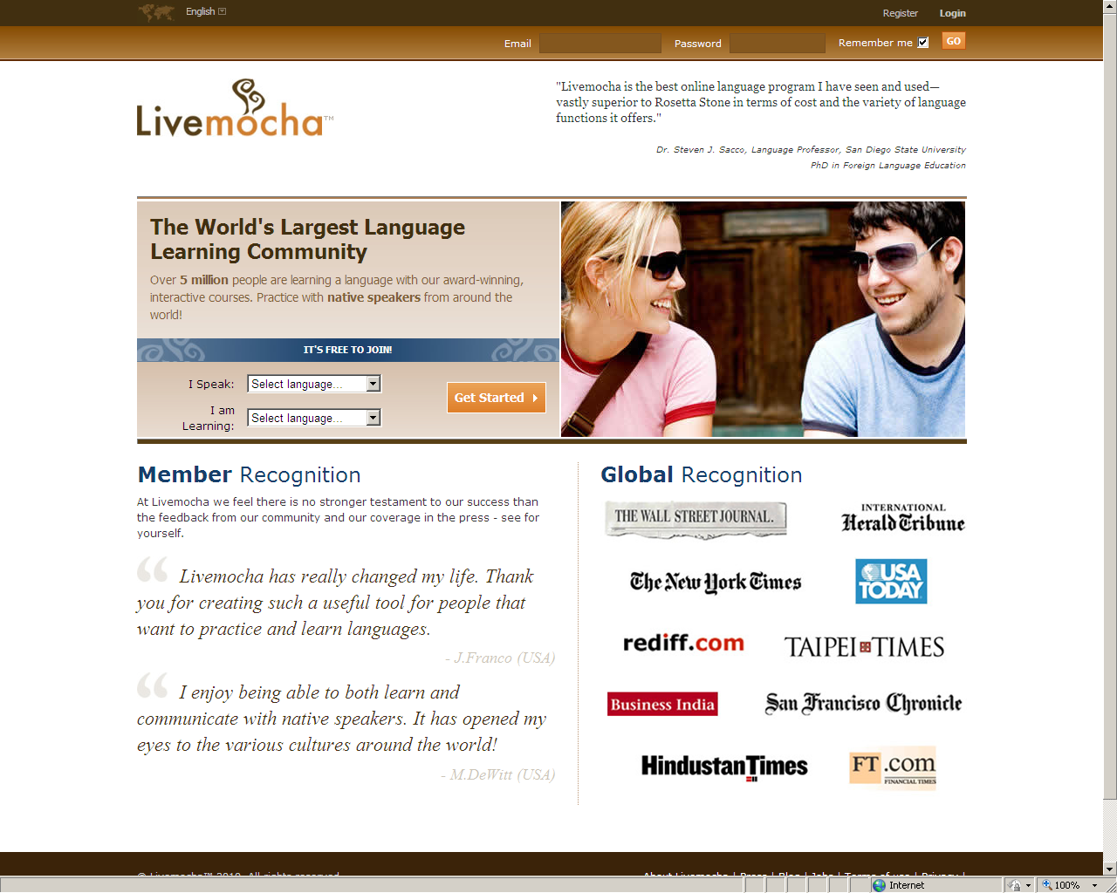
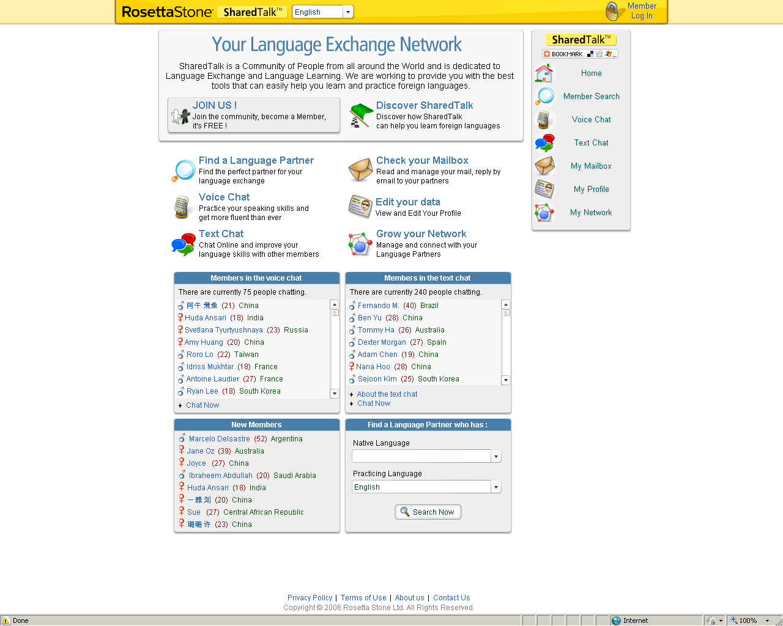
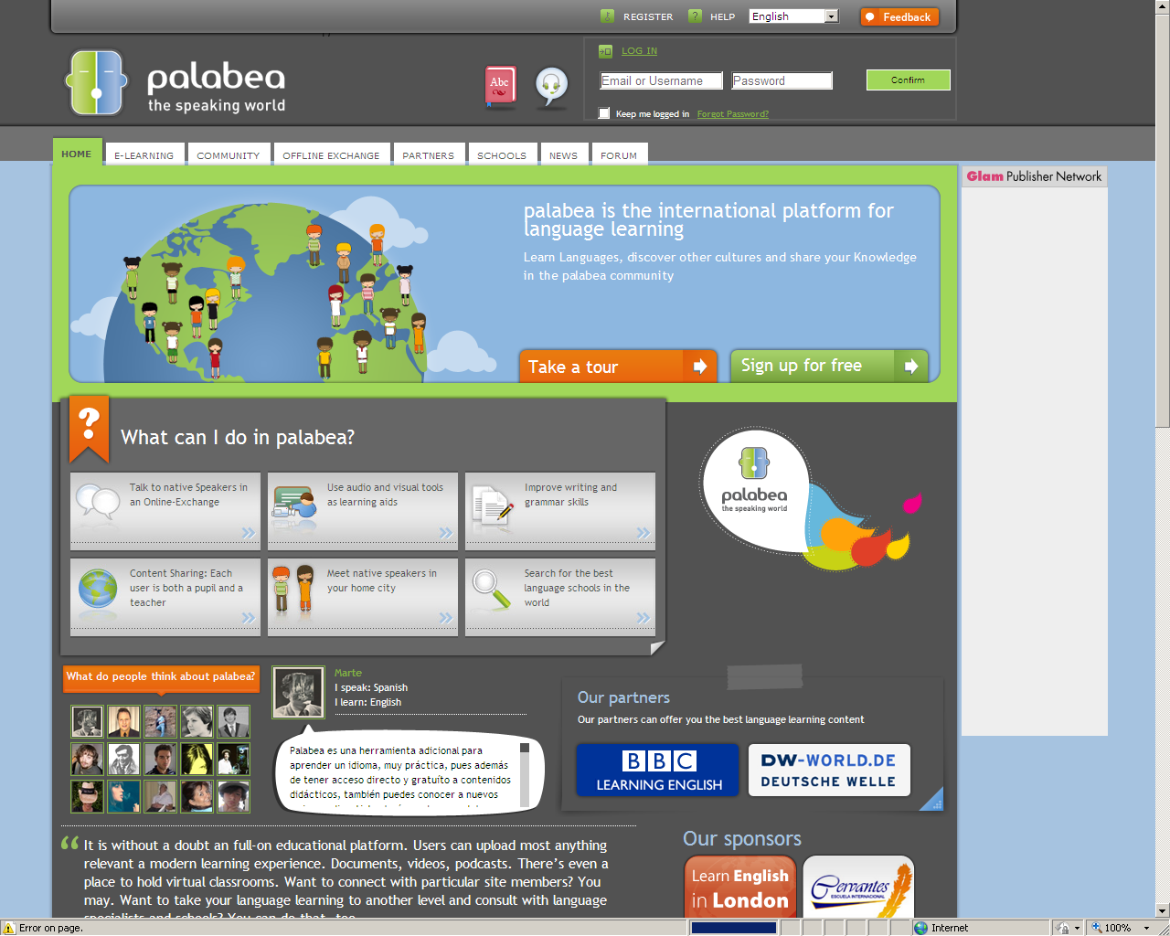
Notes:
There are a multitude of examples

Slide 26
Language Learning SNS Functionality
Web-based, or increasingly app-based
Freemium model
Synchronous voice and synchronous and asynchronous text chat and e-mails
Contain picture-based learning materials
Peer review of written and spoken submissions
Profile matching (languages, levels)
Motivational tools (berries, league tables, corrector badges)

Slide 27
Individual learning
Community learning
1
2
Marcel
teach
Susanne
+
teach
native
native
medium
beginner
beginner
Content based on 150+ different topics (e.g. telling the time, answering the phone, etc..)
Grammar material provided by PONS and Collins
Supported by photos and voices of professional voice artists
Language material available in Spanish, German, French, English, Italian, Russian, Turkish, Polish, Portuguese, Arabic, Japanese and Mandarin
Instant video-chat application for direct conversation between users
Peer-to-peer correction of writing and speaking exercises by the community
Currently around 100,000 unique user visits per day and more than 25,000 text corrections per day.
Notes:
The site can be divided into two clear parts.
Individual and Community learning.
Also, Bulletin boards for users to discuss any language related topic.
16 million users worldwide.

Slide 28
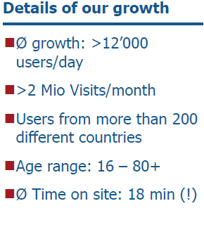
busuu.com is Europe’s largest language learning community with more than 2.5+ million users
Growth of community
Awards & recognition
AlwaysOn Global 250 Winner
Today there are more than 2,500,000 registered users
European Union innovation award in language learning
More than 1,600,000 users
CeBIT Innovation Award
Shortlist best European Website
Winner Open Talent Competition
Red Herring European Winner 2010
May 08
Jan 09
May 09
Jan 10
May 10
Mar11

Slide 30
Freemium Model
Premium
Free
Vocabulary in English, Spanish, French, German, Italian, Russian, Portuguese
Writing exercises
Reading comprehension exercises
Video Chat Application for live-talk
Interactive exams
Audio for more than 3,000 key phrases
Listening comprehension exercises
Printable PDFs for more than 150 units
Access to more than 35 Grammar Units
Audio Podcasts for more than 150 units
Live Video Units
Customized Review
Travel Courses
Voice Recording Feature + more...
+ Access to detailed Grammar guides!
Notes:
Premium Functionalities
The benefits of the above mentioned functions should speak for themselves
Missing Premium Features
No advertisements are shown
Busuu.com certificate for finishing each level
Access to the Guardian.co.uk articles for those learning English.

Slide 31
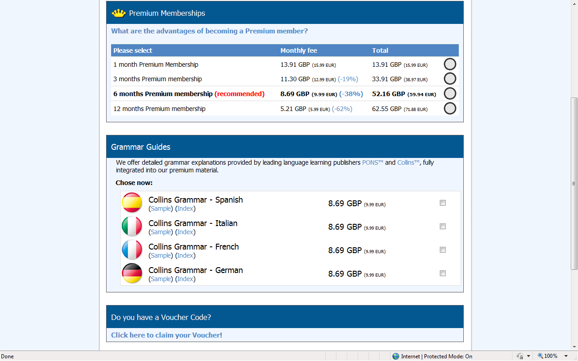

Slide 32
The Research
12 level 3 learners spent 3 months learning German on the site – questionnaires, log sheets and classroom observations. Mostly British aged 21.
Similar experiment 12 months later.
LLAS e-Symposium Practitioners Workshop - 13 practitioners took part in a 3hr workshop and discussion – questionnaires. Mixed European nationalities aged 25-60.
Notes:
Likert scale: a method of ascribing quantitative value to qualitative data, to make it amenable to statistical analysis.
Didn’t collect data regarding whether they taught predominantly on Uni courses of on UWLPs.

Slide 33
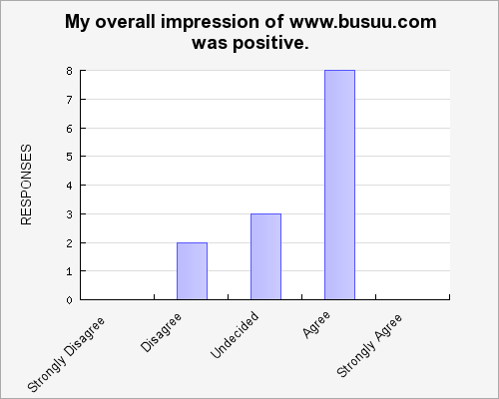
Notes:
Practitioners. Overall quite positive. No one strongly agreed or strongly disagreed.

Slide 34
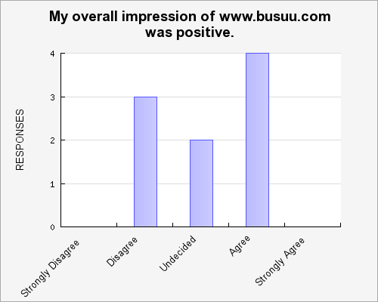
Notes:
Learners. Overall quite positive too but less so than the practitioners. No one strongly agreed or strongly disagreed.

Slide 35
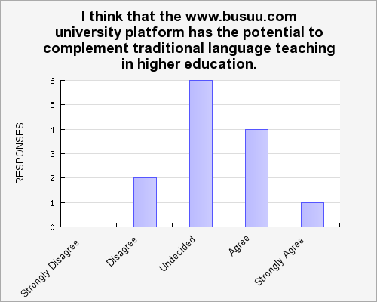
Notes:
Practitioners. Less emphatic but 5 either agreed or agreed strongly. Only 2 disagreed.

Slide 36
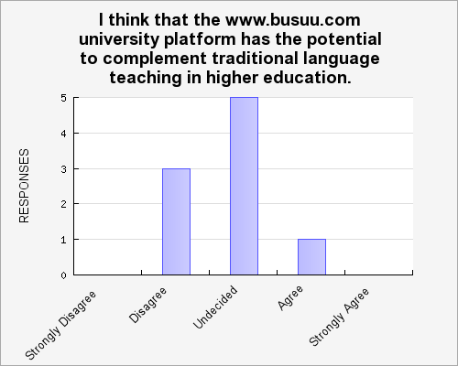
Notes:
Learners. Far less emphatic than the practitioners but 6 (approx 66%) either agreed or agreed strongly. 3 disagreed.

Slide 37
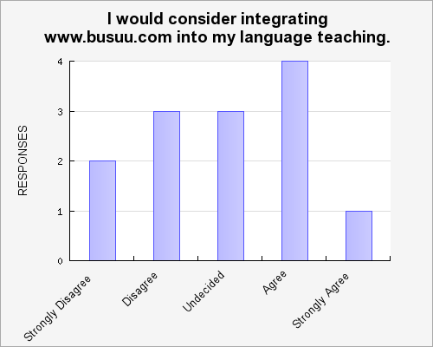
Notes:
Only asked the question to practitioners. Even less emphatic. As many stongly disagreed or disagreed as agreed or strongly agreed.

Slide 38
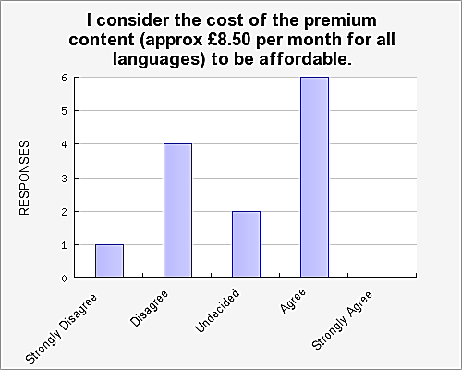
Notes:
Practitioners. Almost half thought it was affordable.

Slide 39
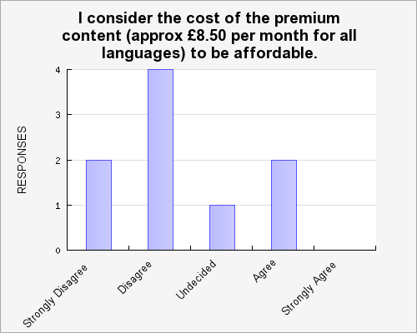
Notes:
Learners. Vast majority didn’t think it was affordable.

Slide 40
Notes:
Pracritioners. Their views on the learning materials differed widely.

Slide 41
Notes:
Students. Their views on the learning materials were largely positive.

Slide 42
Notes:
Practitioners. Almost two thirds said they would use the site in the future.

Slide 43
Notes:
Learners. Far less positive.

Slide 44
Please suggest any ways in which you think the www.busuu.com university platform could be improved. Please suggest any ways in which you think the www.busuu.com university platform could be improved.
“More natural pronunciation and dialogues reflecting current and authentic use of language. Dialogues were stilted and over-articulated, often with the same voice playing 2 parts which makes it hard to follow. It was hard to work out how to get into things - unintuitive interface. The tour wasn't enough to figure out the navigation.”
Notes:
Criticism of materials, in particular dialogues and site navigation.

Slide 45
“Exercises and activities for levels higher than B2.”
“It is not challenging enough for students of A level quality."
Notes:
Materials only cover lower levels but opportunity exists to practise higher levels via chat and video conferencing

Slide 46
“In comparing busuu to livemocha, busuu is less structured and it is hard to know 'where to go next' sometimes in busuu. The site navigation seems a bit chaotic.”
Notes:
Some learners prefer Livemocha.
Far greater investment $15 million vs less than a million.
Navigation superior?

Slide 47
Name three things you liked
“Garden metaphor, the berries and the visual design.”
“Games, chat, reviews”
“Access to a real community of learners live chat peer learning.”
“I wrote a message to an online student and he responded very quickly. The length of a lesson is good. I like the frequent tests.”
“Instant feedback. Self-correcting exercises, social networking.”

Slide 48
Name three things you didn’t like
“The lesson tooltip hardly ever gives an indication of the grammar covered. The tests are too predictable, too easy. It would be good to have levels C1 and C2 as well.”
“Danger for incorrect feedback. Too open for possible frauds.”
“No way to guarantee that feedback received is accurate and reliable Speakers' accents on listening tasks sound artificial.”
“The level was far too basic. My sentences got corrected very quickly (good!) but some of the corrections were wrong - there is no quality control.”

Slide 50
Strengths
Basic features free of charge
Immediate peer review and chat with native speakers
Flexibility (anytime, anywhere)
Fun and motivating
Autonomous learning

Slide 51
Weaknesses
Lack of expertise from peer feedback
Need to pay for premium content (and higher levels)
Learning materials could be improved (behaviouristic)
Unsolicited advances and inappropriate advertising
Notes:
Likely to become more sophisticated.
More premium features.
Further development of apps.

Slide 52
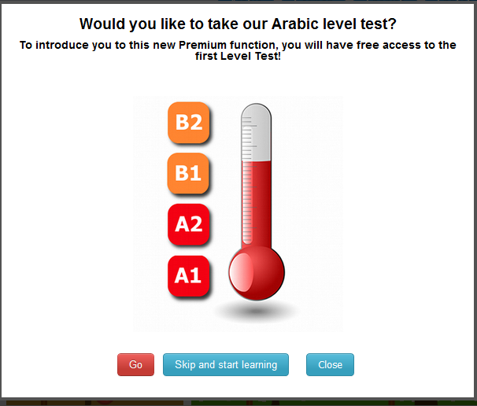

Slide 54
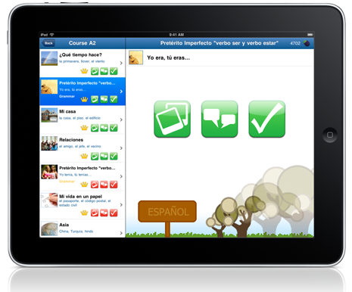
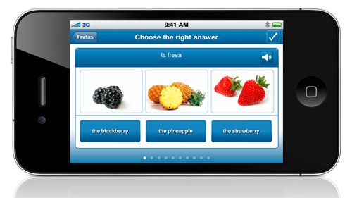
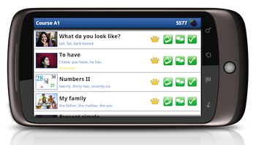
Notes:
Three bussu apps
No internet connection.
Synchronise with your profile
Reduced functionality.
10 million app downloads. 20,000 per day.
Available free of charge.

Slide 55
References
boyd d m, & Ellison N B (2007), ‘Social networks: Definition, history, and scholarship’, Journal of Computer-Mediated Communication, vol. 13, no. 1, [online] available from http://jcmc.indiana.edu/vol13/issue1/boyd.ellison.html [23rd May 2011]
Brick, B. (2011) How effective are web 2.0 language learning sites in facilitating language learning? Compass: The Journal of Learning and Teaching at the University of Greenwich. Issue 3, 57-63
Brick, B. (2011) Social Networking Sites and Language Learning. International Journal of Virtual and Personal Learning Environments. 2 (3) 18-31 (Copyright 2010, IGI Global, www.igi-global.com. Posted by permission of the publisher.) [31st August 2011]
Brick, B, (forthcoming 2012) The Role of Social Networking Sites for Language Learning in UK Higher Education: the Views of Learners and Practitioners International Journal of Computer-Assisted Language Learning and Teaching
Godwin-Jones, B (2005) Emerging technologies: Skype and Podcasting. Disruptive technologies for language learning. Language Learning & Technology, 9(3), 9-12.
Guo, S (2010) From printing to Internet, are we advancing in technological application to language learning? British Journal of Educational Technology Vol 41 No 2 E10-E16.
Harrison, R . & Thomas, M. (2009) Identity in Online Communities: Social Networking Sites and Language Learning. International Journal of Emerging Technologies & Society Vol. 7, No. 2, 2009, pp: 109 – 124. [Online] available from <http://www.swinburne.edu.au/hosting/ijets/journal/V7N2/pdf/Article4-HarrisonThomas.pdf> [23rd May 2011]

Slide 56
Hurd, S (1998) “Too carefully led or too carelessly left alone”? Language Learning Journal, No 17, 70-74
Little, D. (2003) Tandem Language Learning and Learning Autonomy. In Lewis, T. and Walker, L. (eds.), Autonomous language learning in tandem. Sheffield: Academy Electronic Publications
Little, D. (2003) Tandem Language Learning and Learning Autonomy. In Lewis, T. and Walker, L. (eds.), Autonomous language learning in tandem. Sheffield: Academy Electronic Publications
McBride, K (2009) Social-Networking Sites in Foreign Language Classrooms In Lomicka, L., & Lord, G. (Eds.) The next generation: Social networking and online collaboration in foreign language learning . San Marcos, TX: CALICO Book Series
Mullen, T., Appel, C & Shanklin, T. (2009). Skypebased tandem language learning and web 2.0. In M. Thomas (Ed.), Handbook of research on Web 2.0 and second language learning (pp. 101–118). Hershey, PA: Igi Global.

Slide 57
WELCOME TO Language Futures : Languages in Higher Education 2012
5th & 6th July 2012
Edinburgh
#LLASconf2012

