Slide 1
The Impact of Real Translation and Group Tasks on Language Students’ Learning Experience (2)
Angela Uribe de Kellett, a.uribe-de-kellett@ncl.ac.uk
Dr Sandra Salin, sandra.salin@ncl.ac.uk
Newcastle University, School of Modern Languages

Slide 2
The Real Translation Project
Aims
Motivate / engage students
Work with charitable organisations
Group work / independent learning skills
Develop skills to enhance employability
How Purposeful ⇒ real tasks Formative ⇒ improvement Reflective / Practical ⇒ for employment Meaningful ⇒ benefit others
To enhance students learning experience, employability and engagement

Slide 3
Key objectives
 | Students’ experience | Employability | Engagement
Using real tasks | •Motivating •Purposeful | •Work experience | •Use by the public
Charitable organisations | •Feel good factor | •Voluntary work •Direct contact with employer | •Helping others •Work for the community
Group work / Independent Learning skills | •Peer learning •Peer support •Self / Peer assessment •Feedback | •Initiative •Coordination •Collaboration •Negociation •Time management •Problem solving | •Peer pressure •Competition
Translate into the foreign language | Language skills Research skills | •Real evidence to employers | •Challenge

Slide 4
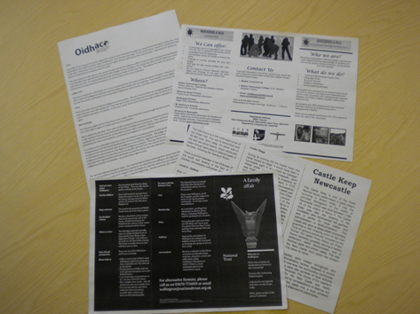
Implementation – the Charities
Different types of charities: local / national / international
Different types of sources: leaflets / websites / video voice over / tourist guides / etc
Different languages:
Spanish – 3 years
French – 2 years
German – 1 year
Notes:
Different charities / different text types
First text – everyone had to do
Second text - choice

Slide 5
This year
Final year language students
Extracurricular activity / Outside classroom
Voluntary participation :
Spanish: 21 students
French: 11 students
German: 8 students
Divided in groups of 2-4 students
Semester 2 (ended before the exam period)
Webpages of a local charity (social and educational needs for children).

Slide 6
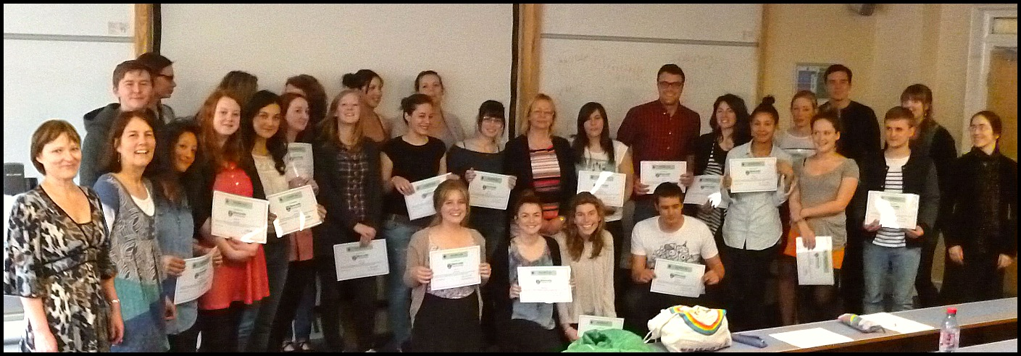
Implementation
First draft individually
Second draft produced in groups & submitted to tutor.
Second draft assessed by tutors
Best translations / pages selected by tutors
Feedback to all students
Editing
Final translations submitted to the charity during a meeting
Certificates to evidence students’ involvement

Slide 7
Evidence collected
Preliminary questionnaire (last year - expectations / working styles).
Final questionnaires (student feedback)
Reflective report (Spanish)
Feedback sessions with tutor (French and Spanish)

Slide 8
Perception shift - Spanish Best features (2010-11)

Slide 9
Final questionnaire analysis 2011-12 (29 questionnaires received:14 for Spanish/10 for French/5 for German)
What impact did the fact that the text was a real text have on your motivation? | What impact did the fact that the text was for a charity have on your motivation?
Want to get it as accurate as possible as it would be read and used by people (11) | Made me feel good / good cause / for others (10)
Made the translation a reality (3) | Need to get it right / do my best as it is for a real client (4)
Gave a goal to my work (2) | Need to finish it on time and to a good standard (1)
Made me more aware of the target audience’s understanding (1) | Need to translate with the right style / tone (1)

Slide 10
What did you particularly like about this project?

Slide 11
Impact of group work
Less need for a dictionary
Good to compare our work
Useful to choose the best solutions
Good to discuss ideas and suggestions
Easier to spot mistakes

Slide 12
What the students gained
Professionality
Personal satisfaction
Language skills
Extra practice
Real work experience
Team working skills
Confidence
Translation skills
More vocabulary
Organisational skills
Collaboration
Fun
Improved accuracy
Awareness of target reader
Time management skills
Doing something useful
Better awareness of the challenges of web translation
Negociating skills
Better awareness of the life of a translator
Patience
Completing a difficult challenge
Feedback
Initiative
Friendship
Something to enhance my CV
Contacts

Slide 13
Feedback – 100% satisfaction
Very useful / helpful
Given just before the translation exam
Very thorough
I learnt to make more idiomatic phrases
Help me with revising for the final exam
Was able to ask questions about grammatical errors
Explained a few issues we had
Covered all errors with explanations
Helped for both exam and professional translation
Gave important bits of advice for the future
Constructive
Fair
Helped refining the translation

Slide 14
What could be improved?

Slide 15
Conclusion - Learning experience
Success – 96 % would definitely get involved again.
Benefits : group work / work for a charity / real work
Team work - most important (96% - improved quality)
Team work + real task = quality
Benefits of learning through peers (charity + in practice)
Importance of tutors’ feedback
Assessment : Competition/exam “Only one group should win”
Certificate
What’s next?
Improvement: start earlier + one meeting at beginning
Voluntary extracurricular activity / 3 Optional modules
New contacts / more charities / regular supply
Just charities? Choice?
Website

Slide 16
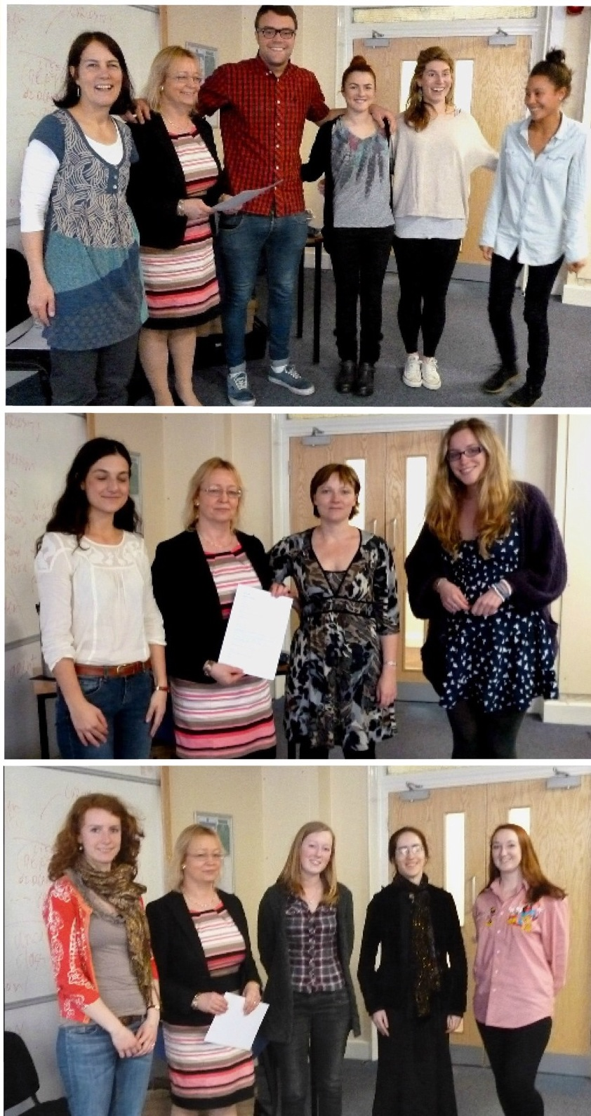
When it comes to graduate recruitment, significant numbers of employers questioned said that the ability to work well in a team (98%), communication skills (96%), and knowledge of foreign languages (67%) were important when recruiting for their companies.
European Commission, November 2010.
http://ec.europa.eu/public_opinion/flash/fl_304_en.pdf

