Slide 1
Challenging the stereotypes: making the case for non-specialist language learning in Caribbean HE
Beverly-Anne Carter
The University of the West Indies
St. Augustine Campus
Trinidad and Tobago

Slide 2
Overview
Introducing The University of the West Indies and the Centre for Language Learning (CLL)
The mission of the CLL
Attaining the vision
Closing thoughts

Slide 3
PART I
Introducing The University of the West Indies and the Centre for Language Learning

Slide 4
A few facts about The University of the West Indies (UWI)
The UWI is a regional university established by Royal Charter at Mona, Jamaica, in 1948.
The St. Augustine Campus (Trinidad & Tobago) was established in 1960 and the Cave Hill Campus (Barbados) in 1962. An Open Campus (with administrative HQ in Barbados) was created in 2008.
The UWI is financed by and serves 16 Caribbean territories. http://www.uwi.edu/
Our motto is “Oriens Ex Occidente Lux” – “A light rising from the West.”
We are the premier university and the only comprehensive one in the English-speaking Caribbean, with approximately 40, 000 undergrad & postgrad students.

Slide 5
The St. Augustine Campus, T&T
The Vice-Chancellery and thus the locus of decision making and governance are on the Mona Campus.
While The UWI prizes its regional character, country campuses are also shaped by local realities. T&T is a hydrocarbon-based economy. The government currently covers 100% of undergraduate and 50% of graduate tuition fees in order to boost tertiary education.
Similarly, although programme and curricula cannot be said to be state-mandated, teaching and research foci, particularly in the STEM disciplines reflect national priorities. Moreover as economic conditions tighten, new programmes (once again especially in STEM disciplines) are invariably conditional on the blessing of/aka funding from the state.
The St. Augustine Campus with approximately 18, 000 students has the largest student population of the three campuses.

Slide 6
The Centre for Language Learning (CLL)
The CLL:
is the campus language centre, administered through the Faculty of Humanities and Education;
was established in 1997 by the then Campus Principal with a mandate to organise and expand the teaching of foreign languages at the St. Augustine Campus;
caters to UWI students, UWI staff and the community;
delivers an IWLP with 10 foreign languages and LSP courses in two graduate programmes;
has a core, commercial (e.g. off-campus courses, a translation & interpretation bureau, EFL) and pro bono publico mission;
has a mixed funding model.

Slide 7
PART II
The mission of the centre for language learning

Slide 8
A snapshot of CLL facts & figures with reference to 2011/2012
906 persons enrolled in on-campus courses in Sem 1 and 883 in Sem 2.
In most languages, there tends to be an equal distribution between students and adult learners.
Most learners pursue a language course as an enhancement/an extra-curricular option.
An internal push for accreditation resulted in the introduction of credit-bearing courses in 2009/2010.
Six (6) students pursued Spanish for credits in Semester 1 and 15 in Semester 2.
~50% of the learners are in Spanish. Hindi and Yoruba, the two heritage languages, usually have the smallest enrolments.
In Mandarin, the newest language on offer, there were 57 persons in Semester 1 and 41 in Semester 2.

Slide 9
A snapshot of CLL facts & figures with reference to 2011/2012
In 2011/2012—there were 10 FT appointments (director, lecturers, visiting lecturers, instructors, FLAs) and 23 PT tutors.
Staff represented 16 countries of origin.
MOUs with India, PRC and Spain provide visiting staff.
Our FLAs are appointed through MOUs with Colombia and France.
The CLL is the only institution in T&T teaching German, Italian, Japanese and Portuguese.
The CLL is the only DELE test centre in the English-speaking Caribbean and assumed responsibility for IELTS in the southern Caribbean in March this year, when the British Council reliquinished that portfolio.

Slide 10
What do we do?
The CLL:
Improves the student experience through a curriculum that focuses on languages for enrichment, communicative purpose, practical skill and employability;
Promotes innovative teaching methods;
Researches language acquisition in adult learners;
Emphasises intercultural communication both in curriculum design and experientially/ is “a site of domestic intercultural experiences” (Simons & Krols, 2010, p. 1);
Administers facilities for language learning (including a SAC);
Enhances the international campus;
Is entrepreneurial and income generating.

Slide 11
The CLL qua language centre
There are similarities among all departments whose primary purpose is to teach and research FLs, as Howarth (2010) contends. Yet, it is clear that language centres have some unique features that differentiate them from more traditional FL departments (Angell et al., 2011; Garrett, 2003; Guarnieri & Usategui, 2000; Lüdtke & Schwienhorst, 2010; Powell, 2003). The differences may apply in any or all of the following areas that Watanabe et al. (2009) see as critical to defining a programme:
Learners
Teaching staff
Curriculum
Locus
Administration
Size
Financing models

Slide 12
Top three challenges in providing non-specialist learning at the CLL

Slide 13
Managing the challenges--curriculum
Accredited courses
Extra-curricular option

Slide 14
Which languages, why, for whom? Our pro bono publico mission
Email re the teaching of Hindi in a community language programme (not linked to the CLL):
“…regarding the proposed scheduling of a Conversational Hindi Class, we advise that to date we have received responses from only 4 persons who have expressed an interest in taking the matter forward…In the event that we do not receive positive responses from at least 12 persons…we advise regrettably ...”

Slide 15
Motivation in foreign language learning/Who are learners?
Traditionally, the concepts of instrumentality and integrativeness (Gardner & Lambert, 1985 ) were the key concepts used to explore motivation towards the target language and culture.
Currently, both the general literature on L2 motivation and the literature specifically on adult L2 learning have been enriched by the examination of other factors that may interesect with motivation, for example, autonomy (Beaton, 2004; Dickinson, 1995; Spratt et al., 2002; Ushioda, 1996, 2000).

Slide 16
The learners & push-pull theory?
In the social sciences, especially in tourism research, push-pull theory is often used in analysing supply and demand for the tourism product.
Push factors may be either individual or social. Pull factors tend to be external. In the tourism literature, pull factors are those that a destination offers to potential visitors.
Push-pull theory provides a useful concept for exploring some of the factors at play in (non-specialist) language learning at the St. Augustine Campus.

Slide 17
Push factors are socio-psychological motives
Desirability of learning a specific FL; FL Communicative Competence
Vocational relevance of linguistic ability
Prestige and status

Slide 18
Pull factors, or what makes the CLL an attractive language learning “destination”
Teaching/learning quality
Native-speaker teachers + C2
Passionate, dynamic teachers
A different, more engaging learning experience ≠ other courses
Facilities available
Number of languages
Affordability, competitive prices
Lifelong learning (<-staff, mature learners, retirees)
Flexibility of schedule
Mixed classes (age, backgrounds etc.)

Slide 19
Response to gap analysis in push-pull theory
In dealing with supply and demand in push-pull theory, one should have:
A realistic understanding of the pull factors
A realistic assessment of the push factors
The ability to respond to the push factors
Recognition of the changing nature of the push factors
(Prideaux & Watson, 2010)

Slide 20
Using research to achieve balance between push and pull factors
“Language Centres at Institutions of Higher Education use applied research activities to develop and increase the quality of all their activities. This research-informed approach to quality assurance is one of the strengths and advantages of being part of the Higher Education sector.”
Wulkow Memorandum on Quality Assurance, 2010

Slide 21
Continuous Improvement
SAY WHAT YOU DO
DO WHAT YOU SAY
PROVE IT
IMPROVE
IT

Slide 22
Continuous Improvement ≠ Applied Research
Continuous Improvement
Applied Research

Slide 23
PART III
ATTAINING THE VISION

Slide 24
Continuous Improvement & Applied Research
Continuous Improvement
Applied Research

Slide 25
Research in language centre contexts
“Research as one of the basic functions of language centres should primarily have pedagogical development as its main target, in line with another of language centres’ basic functions, teaching. Because of their multidisciplinary nature involving several languages and fields, today’s language centres foster and promote interdisciplinary scholarship and research in the teaching and learning of languages…

Slide 26
Research and development in language centre contexts
“… a language centre must constantly evaluate and update its own functions, and proactively develop those areas that are expected to become essential to the university.” Tuomi, & Rontu (2011, p. 47)
Do we pay attention sufficiently
to the pull factors?

Slide 27
The core functions of a language centre
According to Ruane (2003, p. 3), the following are the core functions of a language centre:
The provision of practical training for non-specialist language learners
The integration of appropriate technology in language learning
Research and development in foreign language education

Slide 28
The UWI St. Augustine Language Policy
Foreign language competence is one of the basic competences of the tertiary educated person. It is a key to national and international citizenship in today’s multilingual and multicultural world. The University of the West Indies St. Augustine Campus will promote and foster student engagement with foreign language learning as it pursues its strategic goal of embedding an international and intercultural dimension in the curriculum.

Slide 29
A realistic assessment of the push factors and the ability to respond to the push factors
Desirability of learning a specific FL; FL Communicative Competence
Vocational relevance of linguistic ability
Prestige and status

Slide 30
Responding to push factors
RDI Fund Thematic Area(s) [check as appropriate]
 |  | Climate Change and Environmental Issues
 |  | Crime, Violence and Citizen Security
 |  | Economic Diversification and Sector Competitiveness
 |  | Finance and Entrepreneurship
 |  | Public Health
 |  | Technology and Society: Enhancing Efficiency, Competitiveness and Social well-being

Slide 31
PART IV
CLOSING THOUGHTS
.

Slide 32
Challenging the stereotypes…
English is enough./L2 proficiency is not important.
Adults can’t learn languages.
L2 competence w/out professional competence is enough.
Non-specialist programmes are less worthy than specialist programmes.
Practice and research are antithetical in FLT./Pedagogical research is not real research.
Championing language learning is a losing proposition, philosophically and financially.

Slide 33
Role of non-specialist learning in Caribbean HE
Global HE
The UWI
St. Augustine Campus
Centre for Language Learning

Slide 34
The vision of the CLL
A Centre for Language Learning that is a national, regional and international centre of excellence for foreign language study and research

Slide 35
References
Angell, J., Du Bravac, S. & Gonglewski, M. (2011). Towards higher ground: Transforming language labs into language centers. IALTT, 39, 1-11. Accessed Nov 10, 2011.
Beaton, F. (2004). Participation, expectation and motivation. Adults learning languages. In H. Harnisch & P. Swanton (Eds.), Adults learning languages. A CILT guide to good practice (pp. 21-34). London: CILT.
Carter, B. (2007). Introducing a language policy at The University of the West Indies St. Augustine Campus. Unpublished document.
Dickinson, L. (1995). Autonomy and motivation: A literature review. Special Issue. System, 23, 165-174.
Gardner, R. C. (1985). Social psychology and second language learning: The role of attitudes and motivation. London: Edward Arnold
Garrett, N. (2003). Language learning centers: An overview. In U. S. Lahaie, G. Bartle, R. Gilgen, M. D. Ledgerwood & A. Ross (Eds.) The IALLT Management Manual. 2nd ed. (pp. 1-9). Wheeling, IL: IALLT.
Guarnieri, M., & Usategui, C. (2000). Developing a language curriculum for non-specialists: from theory to practice and back. In M. Fay & D. Ferney (Eds.), Current trends in modern languages provision for non-specialist linguists. (pp.193-205). London: CILT & APU.

Slide 36
References
Howarth, P. (2010). The relationship between academic departments of modern languages and language centres. Unpublished document.
Lüdtke, S., & Schwienhorst, K. (2010). Language centre needs analysis. Defining goals, refining programmes. Peter Lang: Frankfurt am Main.
Powell, B. (2003). Developing language centres. In D. Head, M. Kelly, E. Jones & T. Tinsley (Eds.), Setting the agenda for languages in higher education (pp. 167-79). London: CILT.
Ruane, M. (2003). Language centres in higher education: facing the challenge.
http://asp.revues.org/1127 [4.01.2011].
Tuomi, U.-K., & Rontu, H. (2011). University language centres in Finland-Role and challenges. Apples-Journal of Applied Language Studies, 5, 45-50.
Watanabe, Y., Norris, J. M., & González-Lloret, M. (2009). Identifying and responding to evaluation needs in college foreign language programs. In J. M. Norris, J. McE. Davis, C. Sinicrope & Y. Watanabe (Eds.), Toward useful program evaluation in college foreign language education (pp. 5-56). Honolulu, HI: National Foreign Language Resource Center.

Slide 37
References
Prideaux, B. & Watson, T. (2010). Rebranding Norfolk Island -- is it enough to rebuild visitor numbers? In Lewis-Cameron, A., & Roberts, S. (2010). Marketing island destinations: Concepts and cases. Oxford: Elsevier, pp. 23-36.
Simons, J. & Krols, Y. (2012). Intercultural competence in professional contexts. Proceedings of cAIR10, the first Conference on Applied Interculturality Research, Graz, Austria, 7-10 April, 2020.
Spratt, M., Humphreys, G., & Chan, V. (2002). Autonomy and motivation: Which comes first? Language Teaching Research, 6 (3), 245-266.
Ushioda, E. (1996). Learner Autonomy 5: The role of motivation. Dublin: Authentik.
Ushioda, E. (2000). Tandem language learning via e-mail: From motivation to autonomy. ReCALL, 12, 121-128.
Wulkow Memorandum on Quality Assurance at Language Centres in Institutions of Higher Education in Europe Second meeting held January 14th to 16th, 2010.

Slide 38
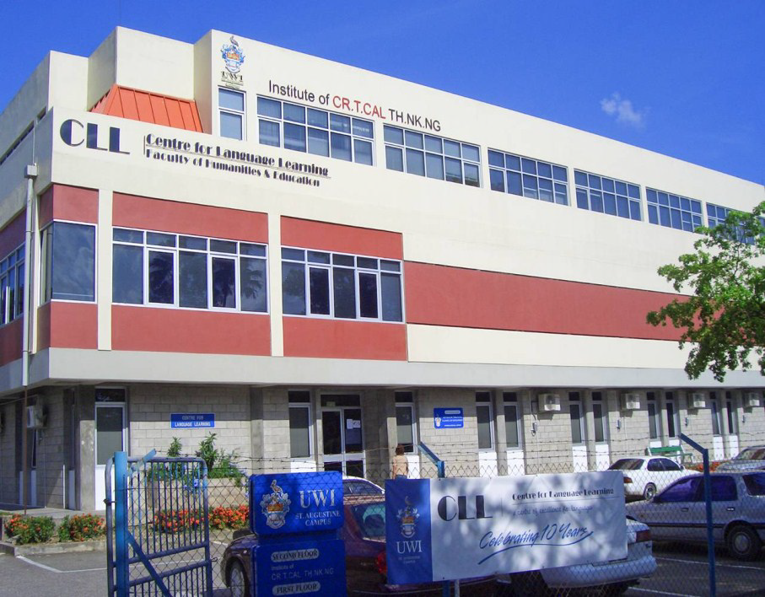
THANK YOU

