Slide 1
Digital Literacy
Fiona Harvey and Lisa Harris
Workshop for LLAS Conference,
26th January 2012
#llaselearn12
#digilit

Slide 2
Fiona Harvey
Fiona Harvey is an Educational Development and Learning Advisor with the Centre for Technology in Educational Innovation at the University of Southampton. She is Chair of the Digital Literacies Special Interest group.
www.elearning.soton.ac.uk
www.twitter.com/fionajharvey
www.linkedin.com/fionaharvey

Slide 3
Lisa Harris
Lisa is a Senior Lecturer in Marketing at the University of Southampton, Director of the MSc programme in Digital Marketing. She is an accredited tutor for the University of Liverpool online MBA programme, and has projects with Alan Rae investigating how ‘early adopters’ of new technology are using Web 2 tools to ‘punch above their weight’
http://lisaharrismarketing.com
www.twitter.com/lisaharris
www.slideshare.net/lisaharris
www.delicious.com/lisaharris1

Slide 4
Exercise 1: What technologies are being discussed here?
“The modern world overwhelms people with data and this is confusing and harmful to the mind” (Conrad Gessner, 1565)
“It will create forgetfulness in the learners' souls, because they will not use their memories.“ (Socrates, 469-399BC)
“It socially isolates readers and detracts from the spiritually uplifting group practice of getting news from the pulpit” (Malesherbes, 1787)
“It might hurt radio, conversation, reading, and the patterns of family living and result in the further vulgarisation of American culture“ (Ellen Wartella, 1962)
“It’s making us stupid” (Nicholas Carr, 2008)

Slide 5
Isn't it just a mechanism
for timewasting
or at its best a space for informal social chatter?

Slide 6
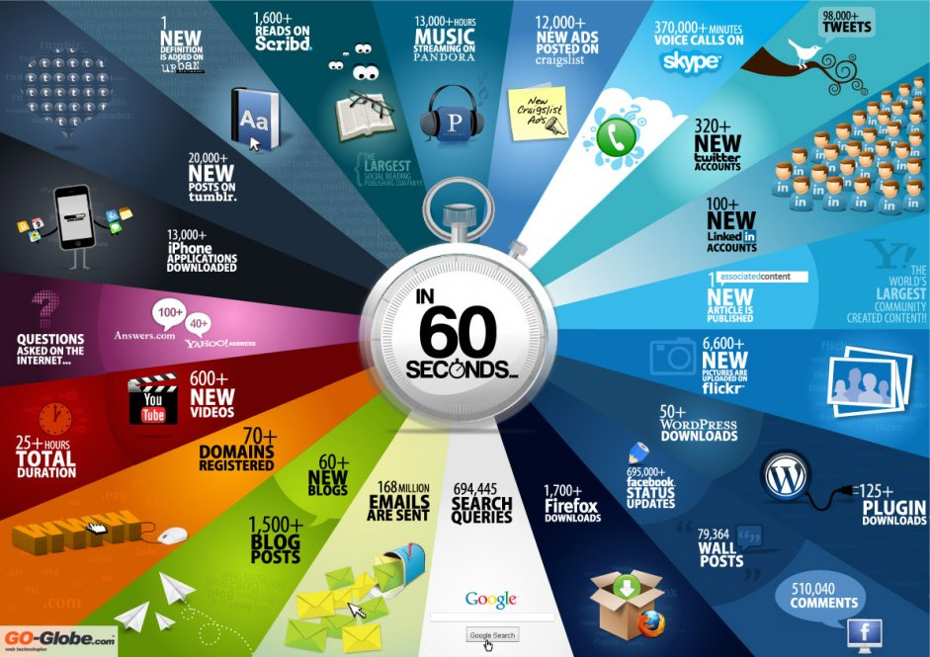
http://www.socialnomics.net/2011/12/28/infographic-every-60-seconds-on-the-web/
Notes:
http://www.socialnomics.net/2011/12/28/infographic-every-60-seconds-on-the-web/

Slide 7
Definitions
“Digital literacy is the ability to locate, organise, understand, evaluate, and analyse information using digital technology. It involves a working knowledge of current tools and an understanding of how they can be used”
“The active management of online activities such as collaboration, networking , content creation and curation in order to “stand out from the crowd” in today’s job market”
“an ability to respond positively to change”

Slide 8
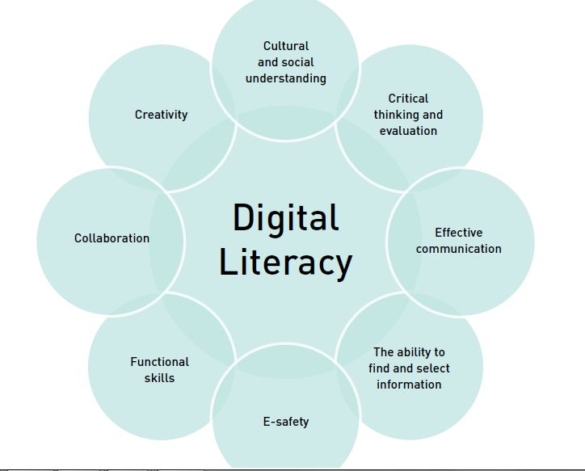
www.futurelab.org.uk

Slide 9
What do we mean by Digital Literacy?
Collecting, managing and evaluating online information
Building an online brand for personal or career development
Creating and curating content in written, audio and visual media
Communicating effectively online for networking and collaboration purposes
Managing digital identity/ies with due awareness of privacy and security issues

Slide 10
The “digitally literate” student…
a proactive, confident and flexible adopter of a range of technologies for personal, academic and professional use
uses appropriate technology effectively to search for and store high-quality information
curates, reflects and critically evaluates the information obtained
engages creatively and productively in relevant online communities
Is familiar with the use of collaboration tools to facilitate groupwork and project management
is aware of the challenges inherent in ensuring online privacy and security
Develops appropriate communication skills for peer and tutor interaction within an ‘always on’ environment

Slide 11
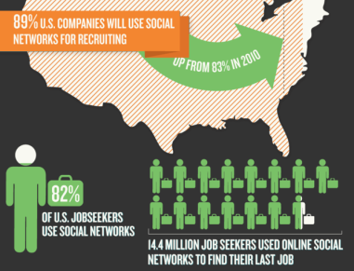
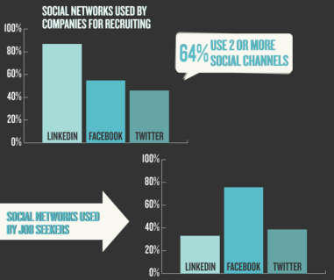
Notes:
http://recruiting.jobvite.com/resources/social-recruiting-survey.php

Slide 12
Fear of new technology...

Slide 13
Exercises
1. Write down what you see as the key elements of digital literacy for your area of expertise. Discuss what you have highlighted and then agree a set of values for a digital literate student (Google Docs)
2 . Identify 3 aspects of digital literacy that you consider most relevant to your own job. Explain why this is the case (Google Docs)
3. Use Mindmeister (http://www.mindmeister.com) to map out the aspects of digital literacies and build your group view of digital literacies.
4. Watch the video ‘Why Digital Literacy Matters’ (http://vimeo.com/28089249) and evaluate how some of the ideas could be taken forward in your area of expertise/opinion.

Slide 14
Social Bookmarking

Slide 15
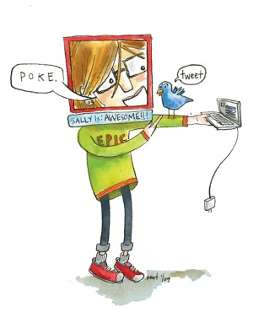
Netiquette
http://www.networketiquette.net/index.html

Slide 16
Online safety
Common sense prevails. Don’t give away information that can lead to unwanted attention. Nothing you post online is private – once you post or send something over a network it can be traced.
http://www.cyberpatrol.com/onlinesafetytips.asp
Online security - http://www.staysafeonline.org/higher-education/students

Slide 17
Useful links
The Networked Student (5 mins)
Eric Qualmann (video, 2 mins)
A vision of students today (video, 5 mins)
Rethinking Education (video, 7 mins)
Assessed student wikipedia contributions (Keynote, LLAS 2011)

Slide 18
More useful links
Digital Literacies for EFL teachers (useful definitions here)http://www.slideshare.net/EvelynIzquierdo/digital-literacy-1515057

